Slide 1
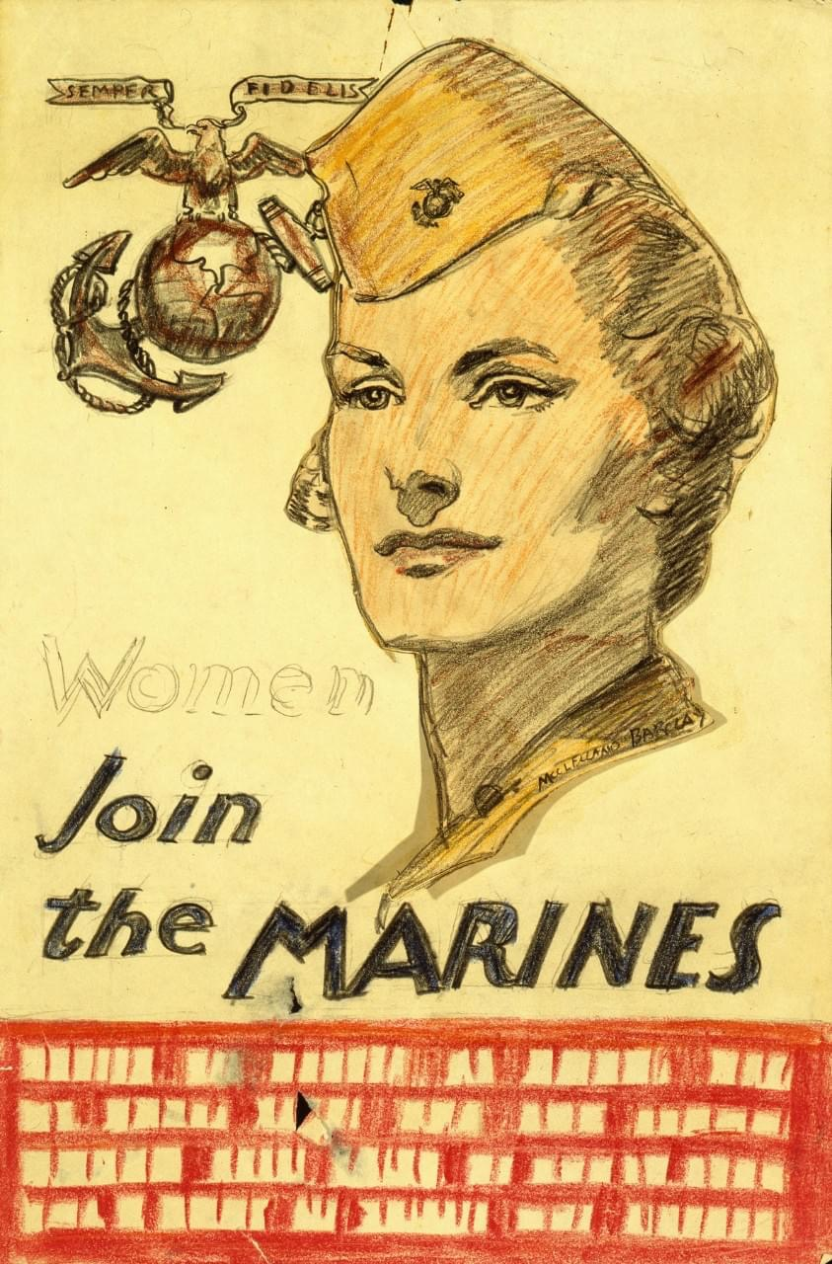
SCUTTLEBUTT
Marine Corps League
Tar Heel Detachment # 733
March 2021
Tar Heel Officers
Jim Lewis Commandant
(502) 931 7332
Mongoose2633@yahoo.com
John Dilday Sr. Vice Commandant
919-602-4483
johndilday2013@gmail.com
Earl Linthicum Jr. Vice Commandant
919-215-5730
linthicj@bellsouth.net
Tyrone Ashe Judge Advocate
Tyrone.ashe57@mail.com
Gene Taxis
Paymaster/ Adjutant
919-448-6596
Gene.marine1@gmail.com
Toby Roberts Sergeant At Arms
USMCToby1@hotmail.com
Sean Van Pallandt Historian
svanpallandt@live.com
Jason Hall Chaplain
jhallmcl733@gmail.com
David Gardener Eagle Scouts Coordinator
gardener1941@att.net
TBD
Capital City Young Marines

Slide 2
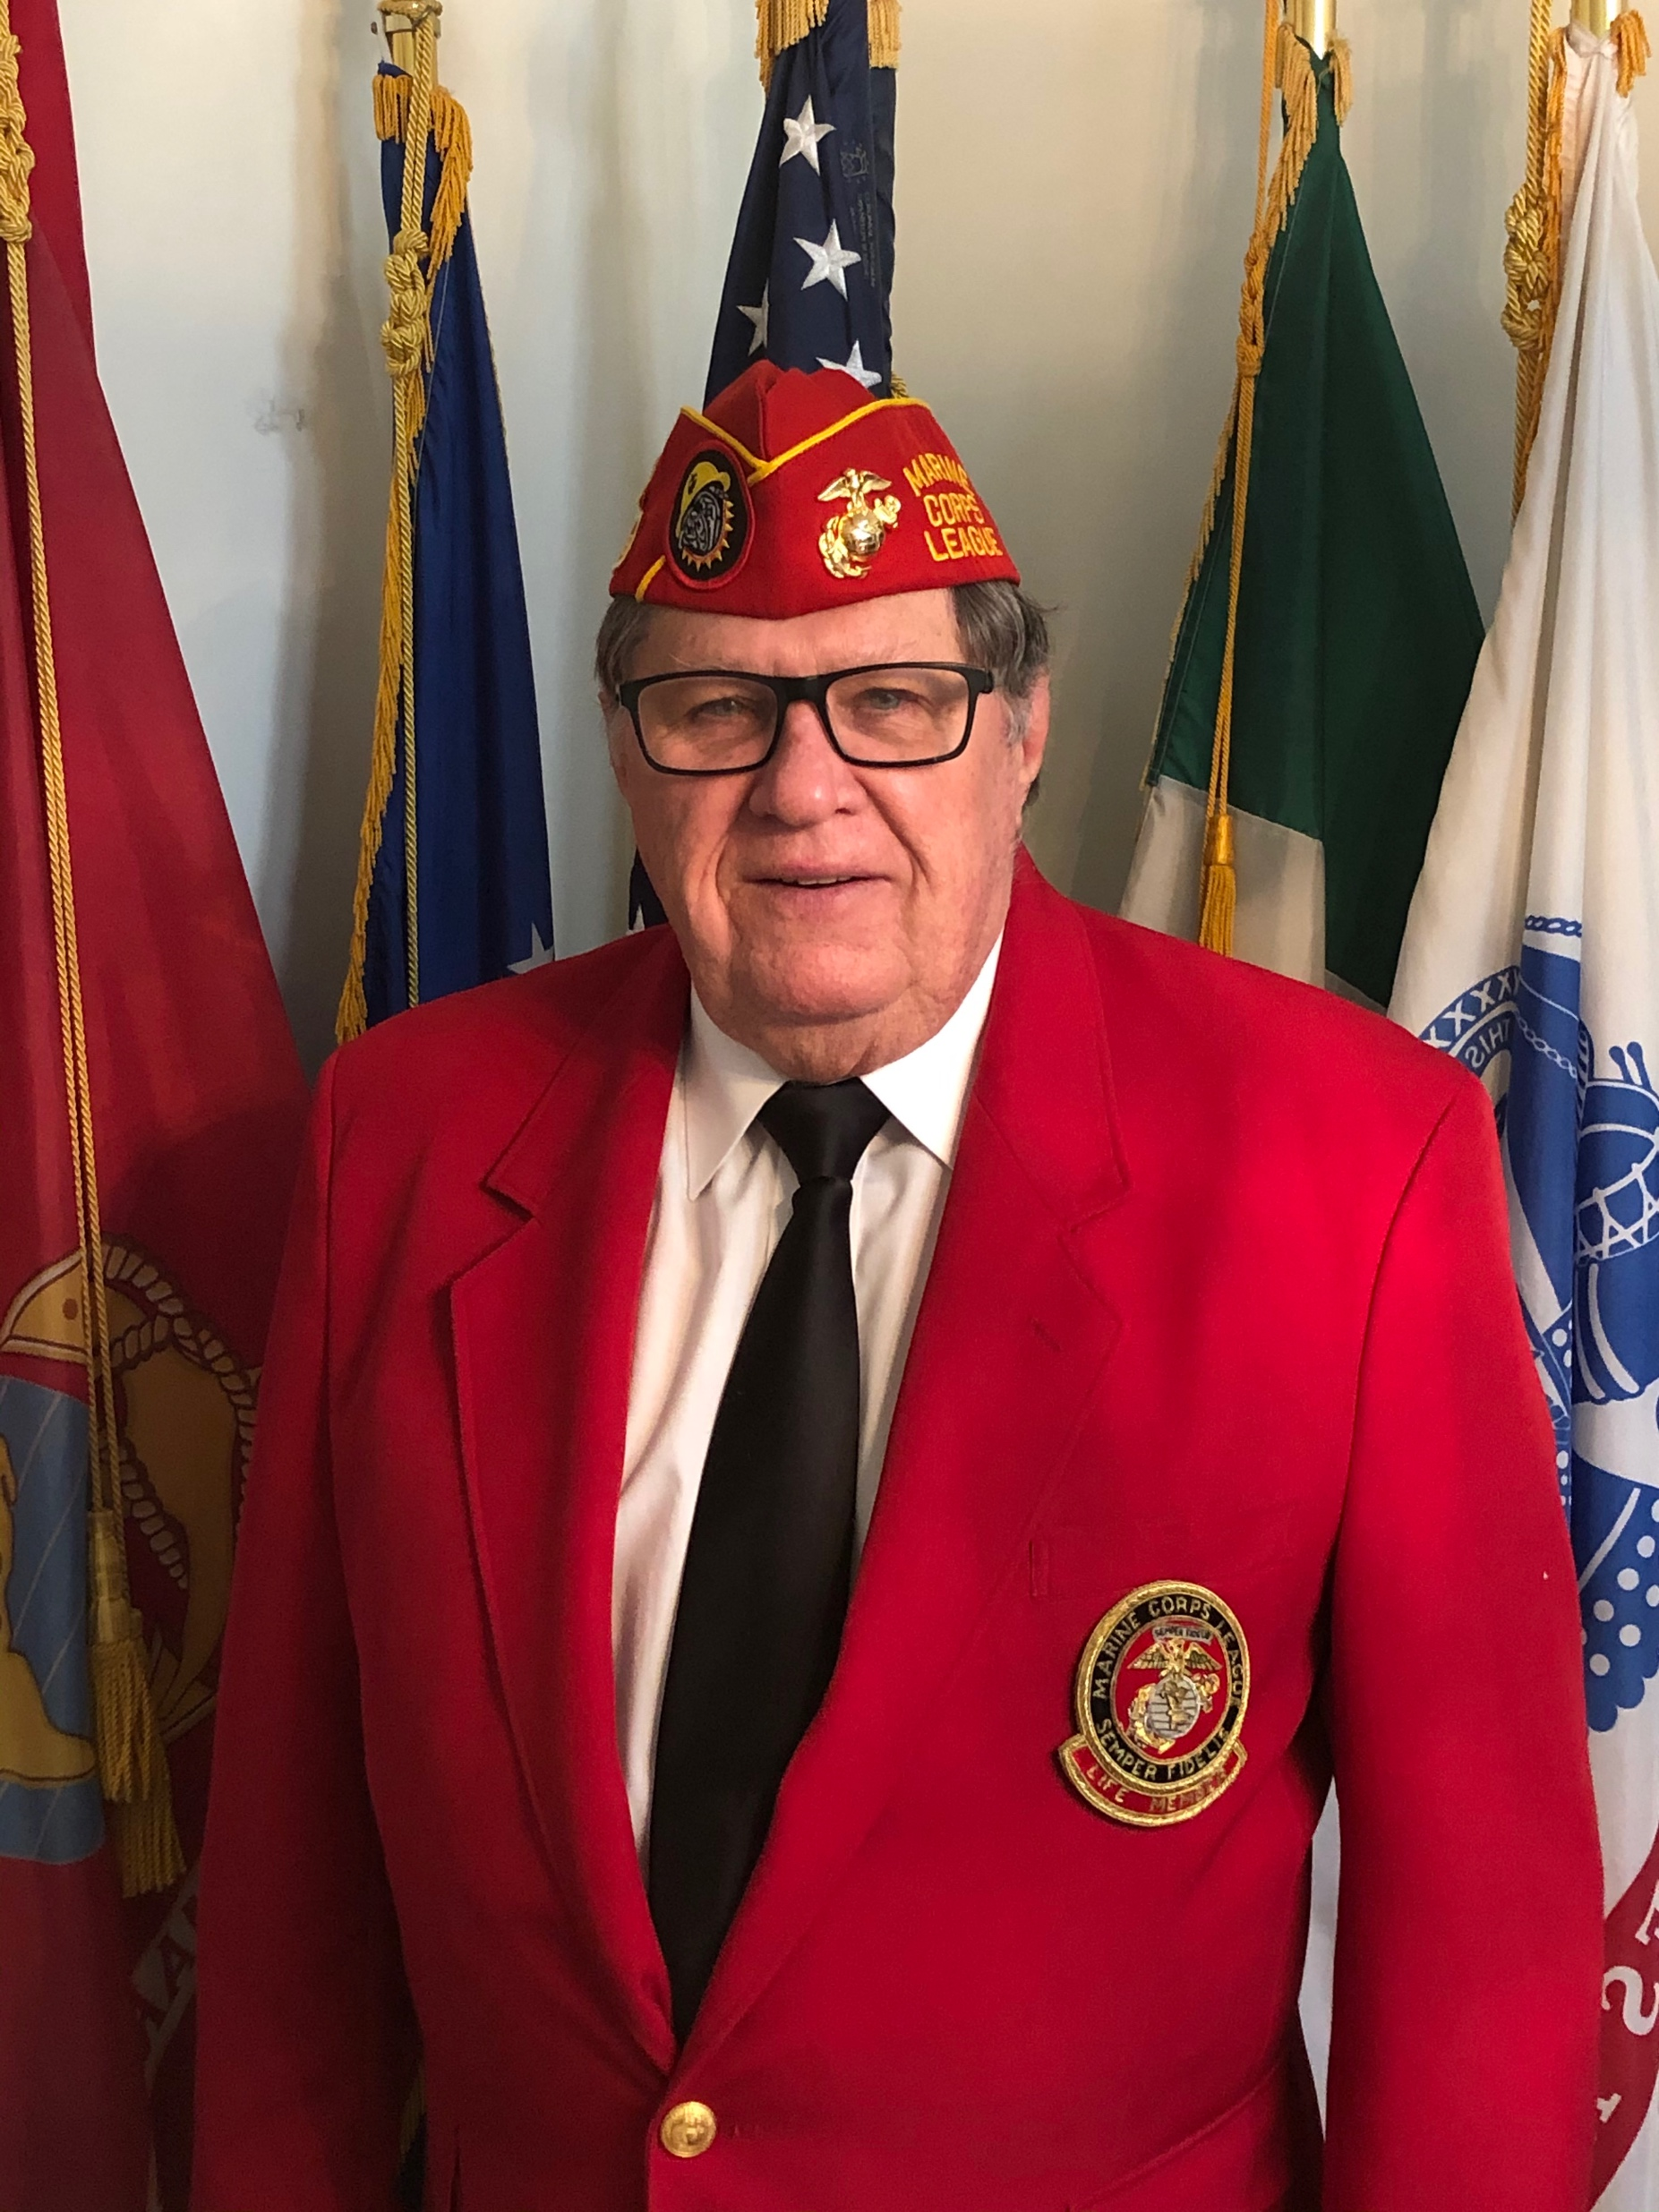
Marine Corps League
Commandant
Fellow Marines:
Me again, and with my first month in the history books, I am still learning. I do, however, have some atta boys to pass out to my fellow marines. The first is to Al Pasquale, an outstanding member of the Devil Dogs and this Detachment. One of the Devil Dog’s missions is to help feed the dogs housed in the Wake County kennels. Typically, most members bring a twenty-five-pound bag of dog food to the meetings. Al showed up with a little over half a ton! Great job, Al! You make us all look good.
My next pat on the back goes to the staff for their continued hard work, but more specifically for their recent assist to Pamela Thomas. She asked for our help donating some items for marines in residence at the Durham VA; cologne, detergent, model car kits, and some small plants. The request came in between meetings and the amount of money to allot was discussed at the staff meeting. Time was running out to respond and our staff stepped up and personally provided the items for Pam, met her at the VA with the donations, and subsequently had a lunch meeting with her to discuss future support for the MCL Auxiliary. That is what marines do. You see a follow marine needing help, you run to them, grab them by their 782 gear, and pull them to safety. We appreciate Pam and her dedication.
I also need to commend fellow marine, Steve Curlee. While the Sgt at Arms is unable to make the meetings, Steve has stepped up and filled the job admirably. Thanks, Steve.
Thanks to the diligent work of Suellen Beaulieu, Russ Oliver and Jason Hall on preparing the budget, it was ready to be voted on at our last meeting. The budget will start on time in April.
Toby Roberts, John Saitta and Tyrone Ashe completed the audit in a timely manner per the bylaws. A sword was presented to the outstanding recruiter by the Senior Vice-Commandant, John Dilday.
Our detachment can walk taller and hold our heads higher, because we are marines and because we walk among this type of people.
Semper Fi,
Jim Lewis Commandant
Tarheel Detachment
A little Irish Humor: “Why did God invent Jameson whiskey?”
(So, the Irish would never rule the world.)
Next Meeting Wed. April 7, 7:00pm
American Legion Post 67
8523 Chapel Hill Rd
Cary, NC 27513
ZOOM Link will be emailed
UPCOMING EVENTS
May 31: Memorial Day
October 23: Beirut Remembrance
November 6: Veterans Day Parade and Lunch
November: The start of Toys for Tots
November 10: Birthday Ball (Exact date to be announced)
December: Christmas Party (Date to be announced)
Wake County Veterans – LAST WEDNESDAY OF EACH MONTH AMERICAN LEGION

Slide 3
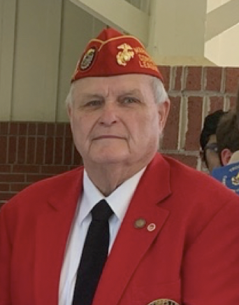
Marine Corps League
Sr. Vice Commandant
Greetings to all Marines and Associates of the Tar Heel Detachment.
Fellow Marines and Associates, the month of March has shown a great start for the new leadership headed by Commandant James Lewis. We started the month by bringing in a new member, David Matthews. David lives in Wendell with his wife Taia. He works at the VA Hospital in Durham and is head of Security. He retired from the Marine Corps after 20+ years as a SSGT. Please welcome him as our newest member.
Also, in March the Tar Heel Detachment hosted the first gathering of Marines and Associates since 2019 as the Department Spring meeting was held at the Doubletree by Hilton on March 12-13. Once again, your Detachment was showcased as a leading Detachment across North Carolina. Making this meeting such a success was a joint effort by several of our Members including James Mitchell, Gene Taxis, Toby Roberts, Earl Linthicum, Tyrone Ashe, Al Pasquale, James Lewis and Pamela Thomas, along with several members of the Auxiliary. Also contributing to the success were several of the wives of these members, including Marilyn Lewis, Gayle Dilday and Jeannie Mitchell who made our hospitality suite such a big attraction with the homemade buffet of delicious food. Assisting with the raffle and 50/50 table was Therese Taxis. A big THANK YOU to each of you for contributing to a great weekend for all the fellow Marines and Associates who came together from all across our state.
Also, a big Thank You to Commander Gregory Erickson and the members of the Drill Team from the Navy JROTC Cadets with Explorer Post 333 who raised the Colors at our opening flag raising ceremony in front of the hotel and for the Posting of the Colors opening our business meeting.
As we move forward our next big event will be our Memorial Day Ceremony at the Capitol Grounds in Raleigh. This committee is headed up by John Saitta, so be ready to assist with any needs he may ask for.
With everyone pitching in, this can be a very successful year for the Tar Heel Detachment. So, join your Fellow Marines and Associates to make it happen.
Thank you in advance for all your help
Semper Fi John

Slide 4
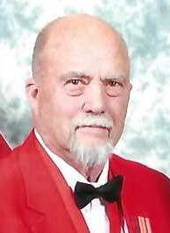
Marine Corps League
Jr. Vice Commandant
Marines,
Hope all is well with everyone and you are getting your vaccinations. I’m ready for this pandemic to be over with. It has held back our usual activities and I miss being able to get together socially.
The rifle raffle is coming along as well as it can be expected with the pandemic limiting the ability to get out and sell tickets. The membership has not responded to the sales of tickets like I had hoped, but we have plenty of time before the November drawing.
A table was set up at the DoNC Membership Meeting and we were able to make some sales for the raffle. The rifle was displayed on the table and everyone was really impressed with it.
We are very close to completing our roster upgrade. Review the password protected members only website at http://www.tarheelmcl.org/ If you have corrections or changes in your address or phone number, please contact me. This roster is for the sole purpose of the membership only. It will not in anyway be shared outside of the league.
If you know of any sickness or distress, please contact me or any of the staff. My email address is linthicj@bellsouth.net.
Have a happy Easter and remember to celebrate its true meaning!
James E. Linthicum, Jr. Vice Commandant

Slide 5
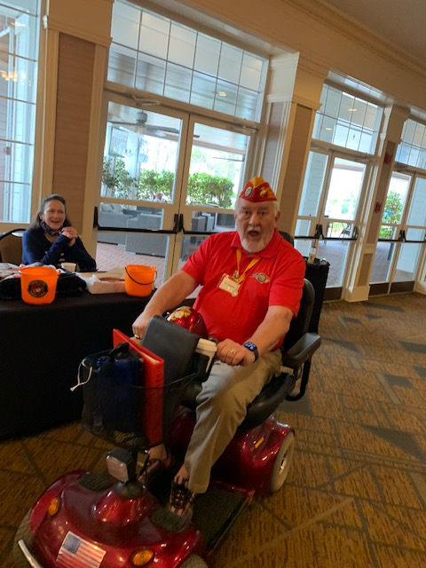
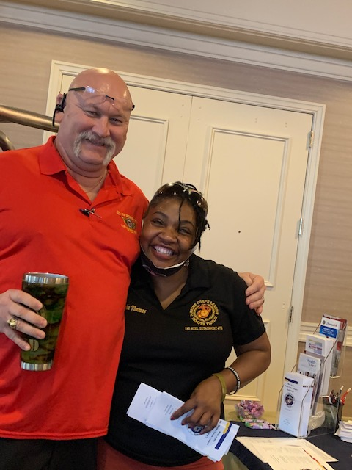
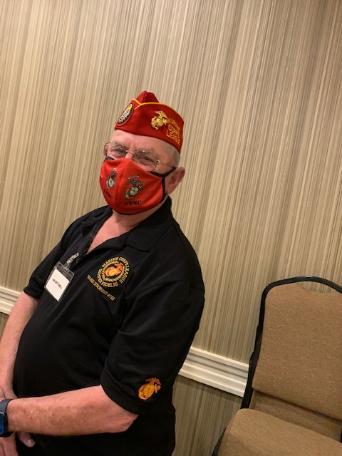
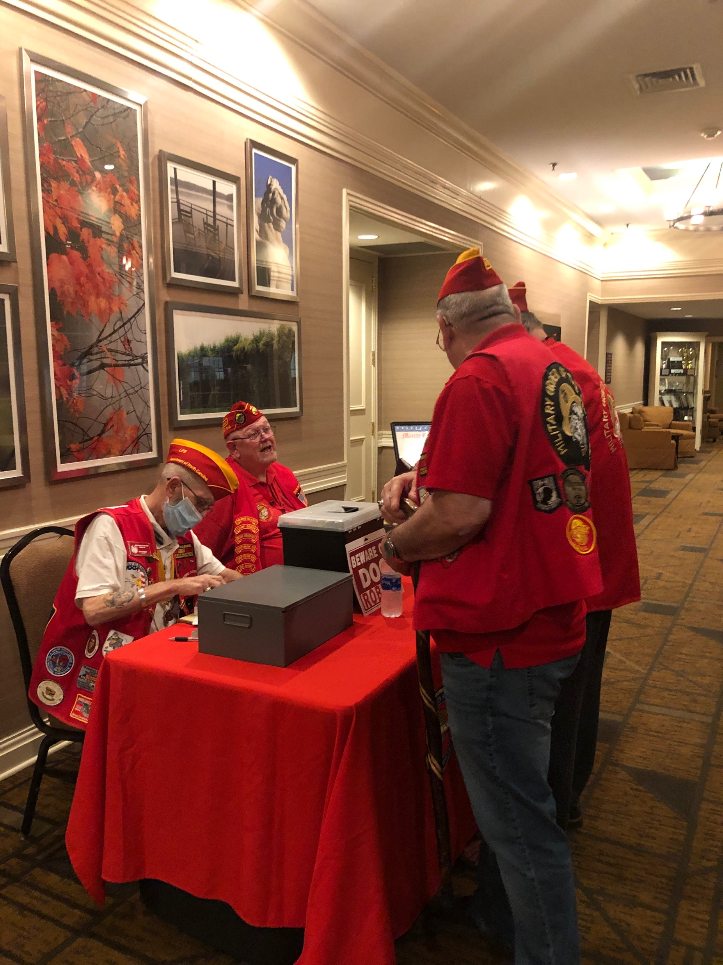
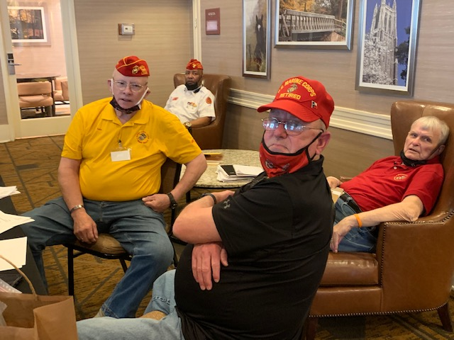
Department of North Carolina
Marine Corps League
2021 Spring Meeting

Slide 6
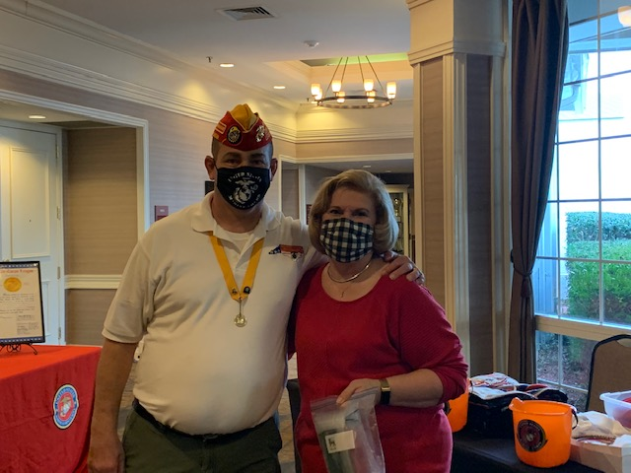
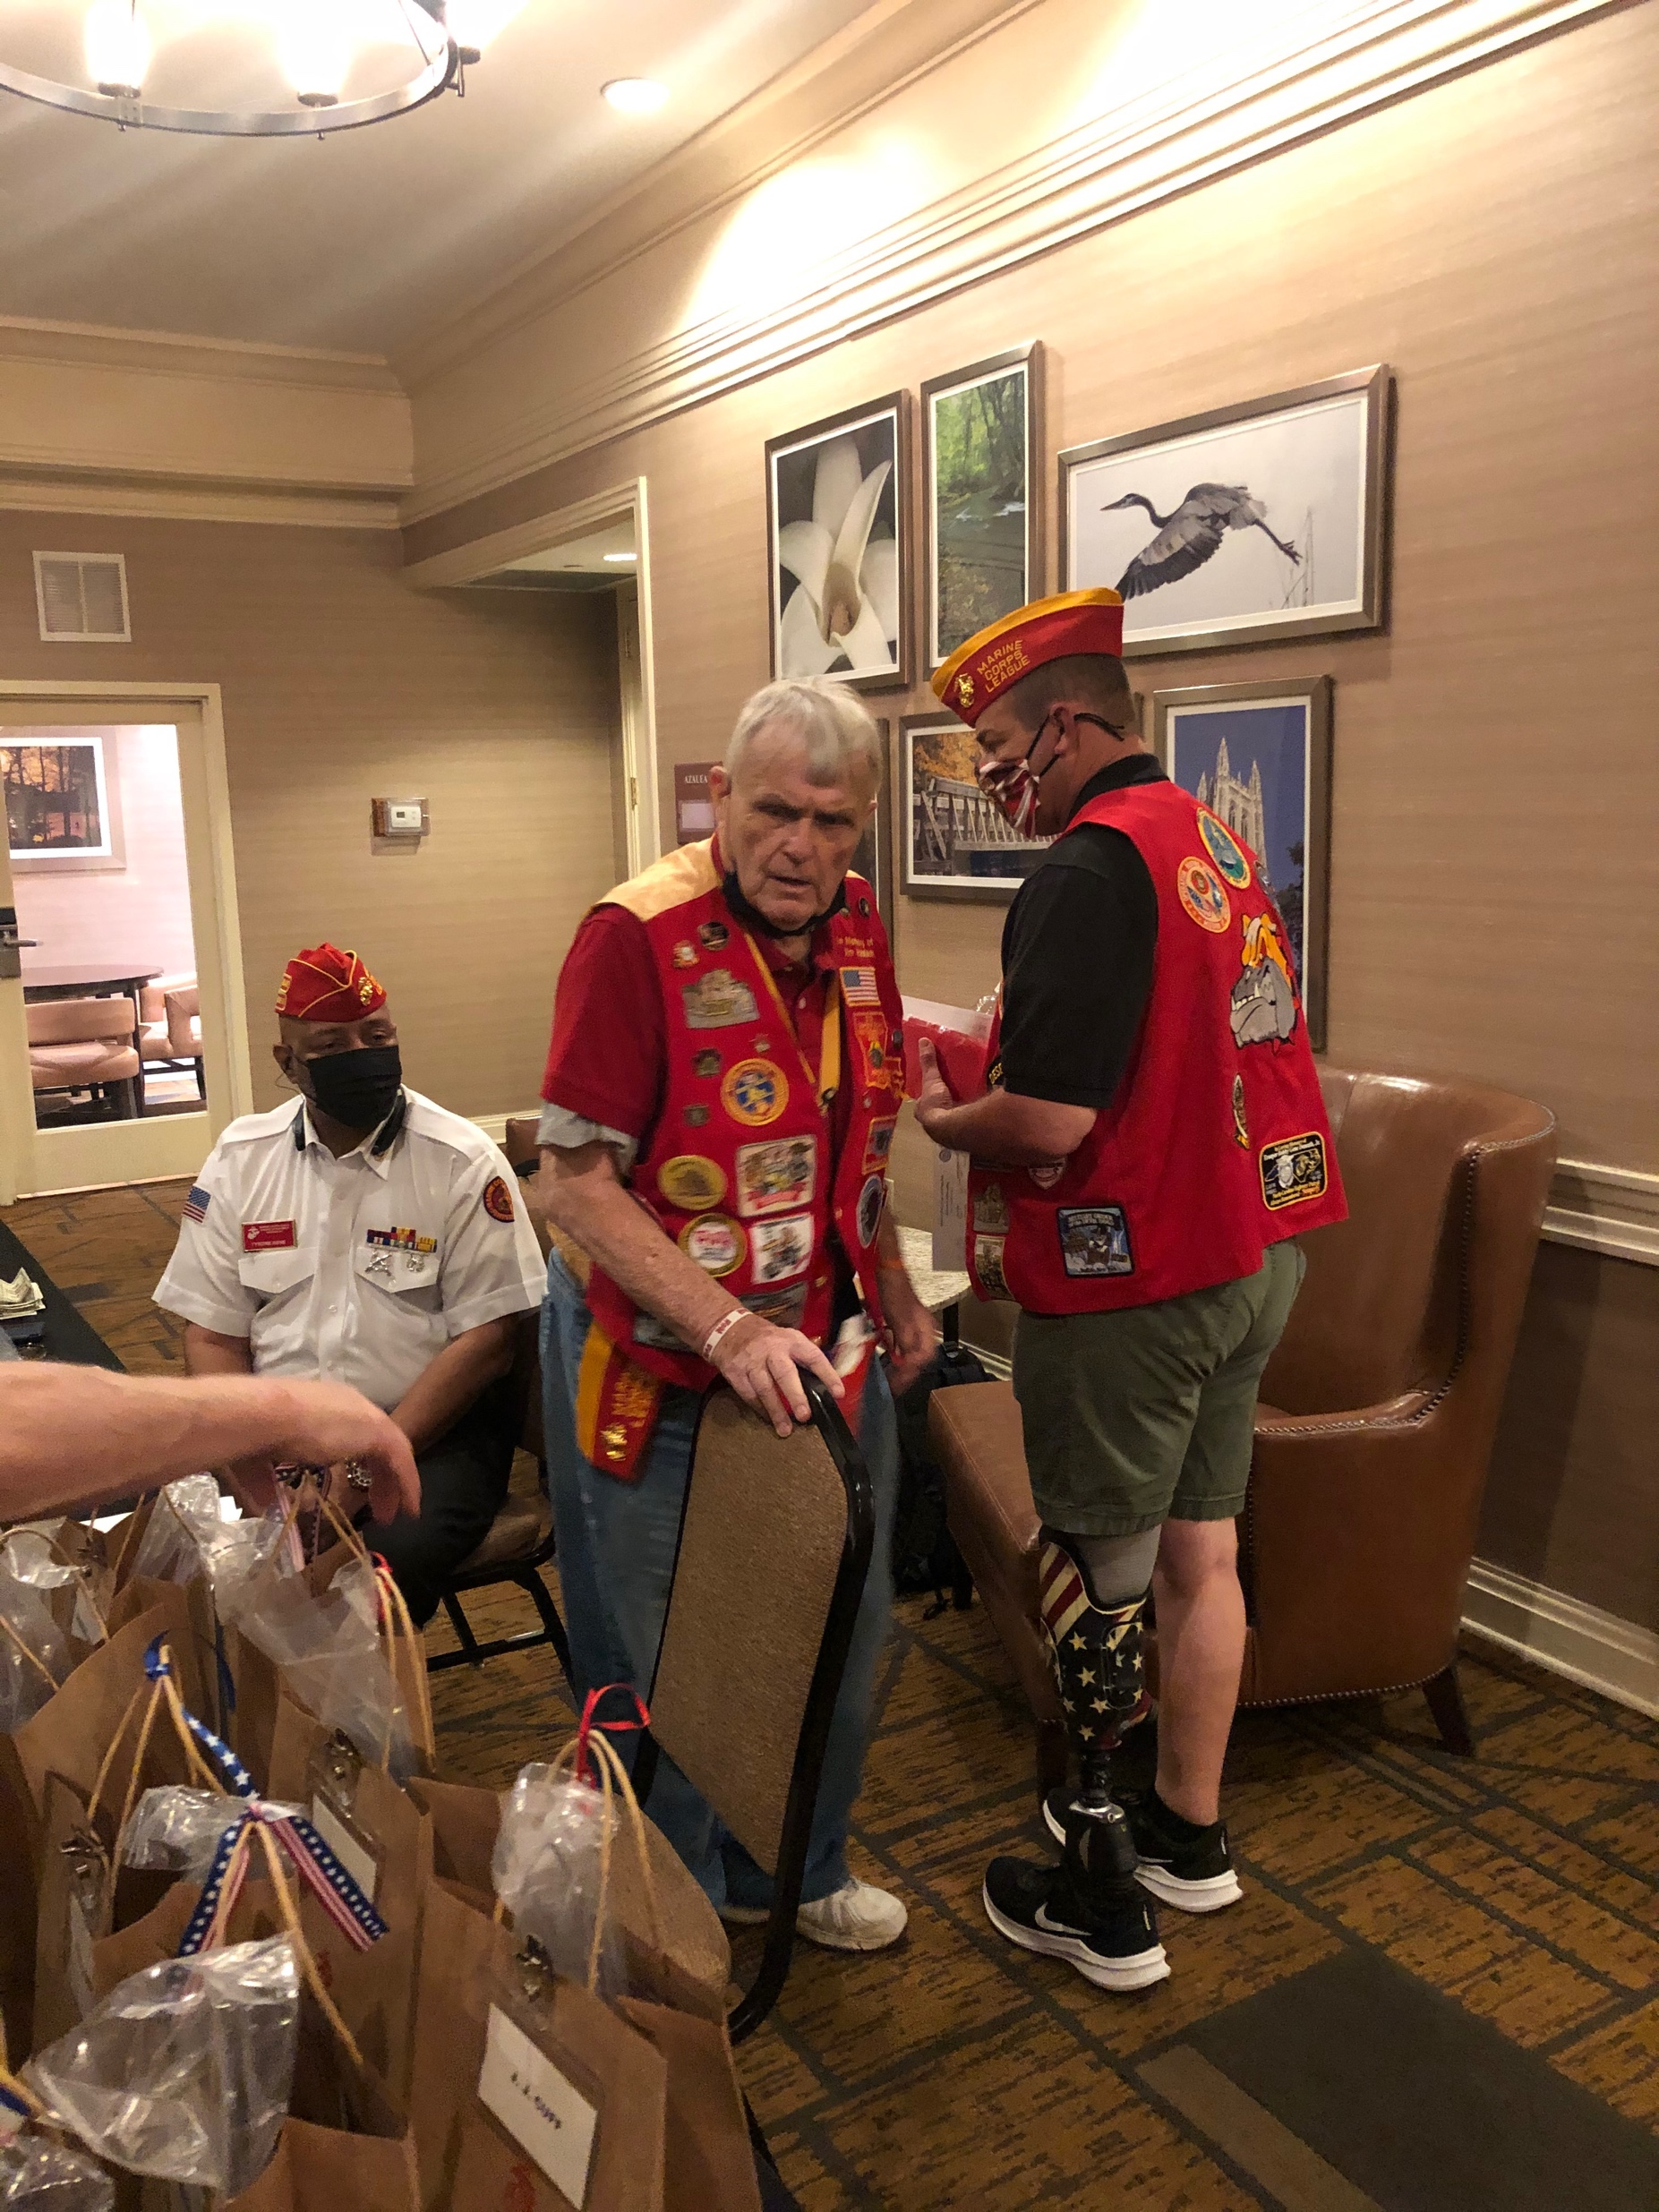
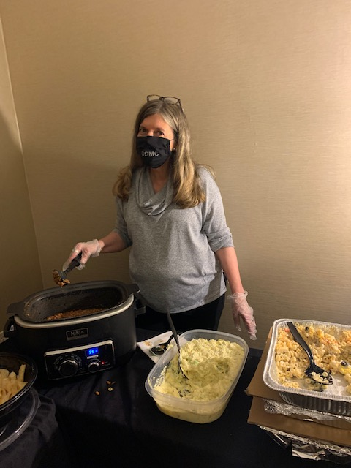
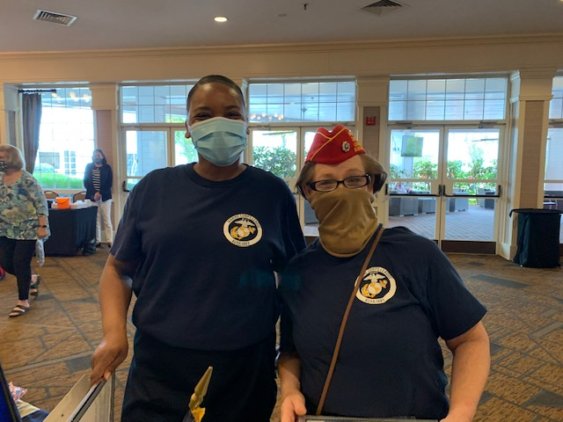
Department of North Carolina
Marine Corps League
2021 Spring Meeting

Slide 7
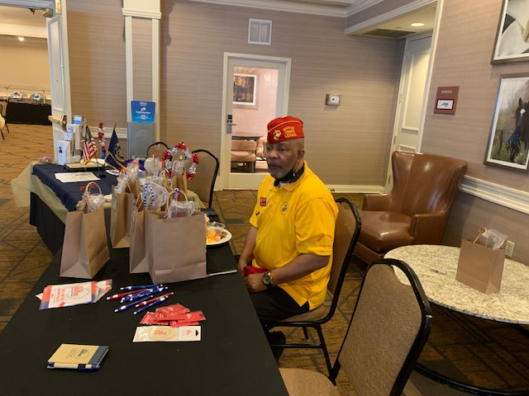
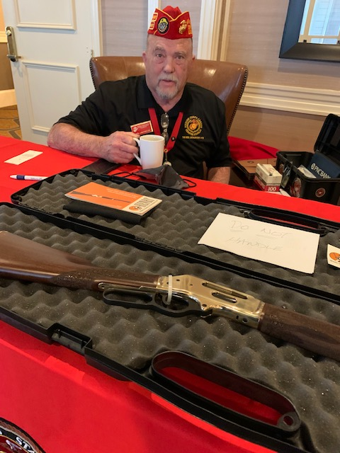
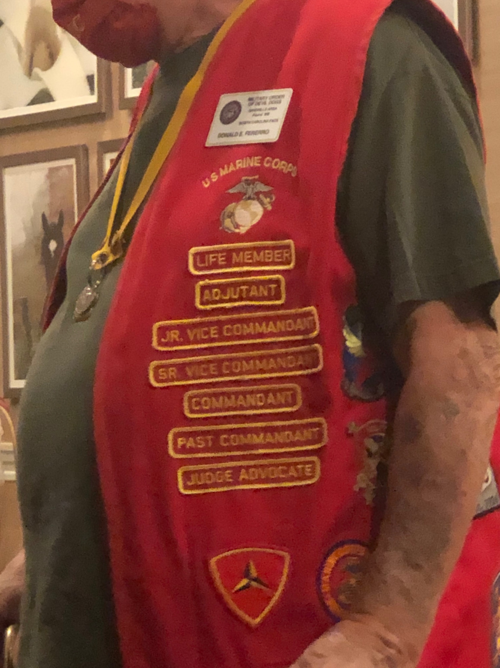
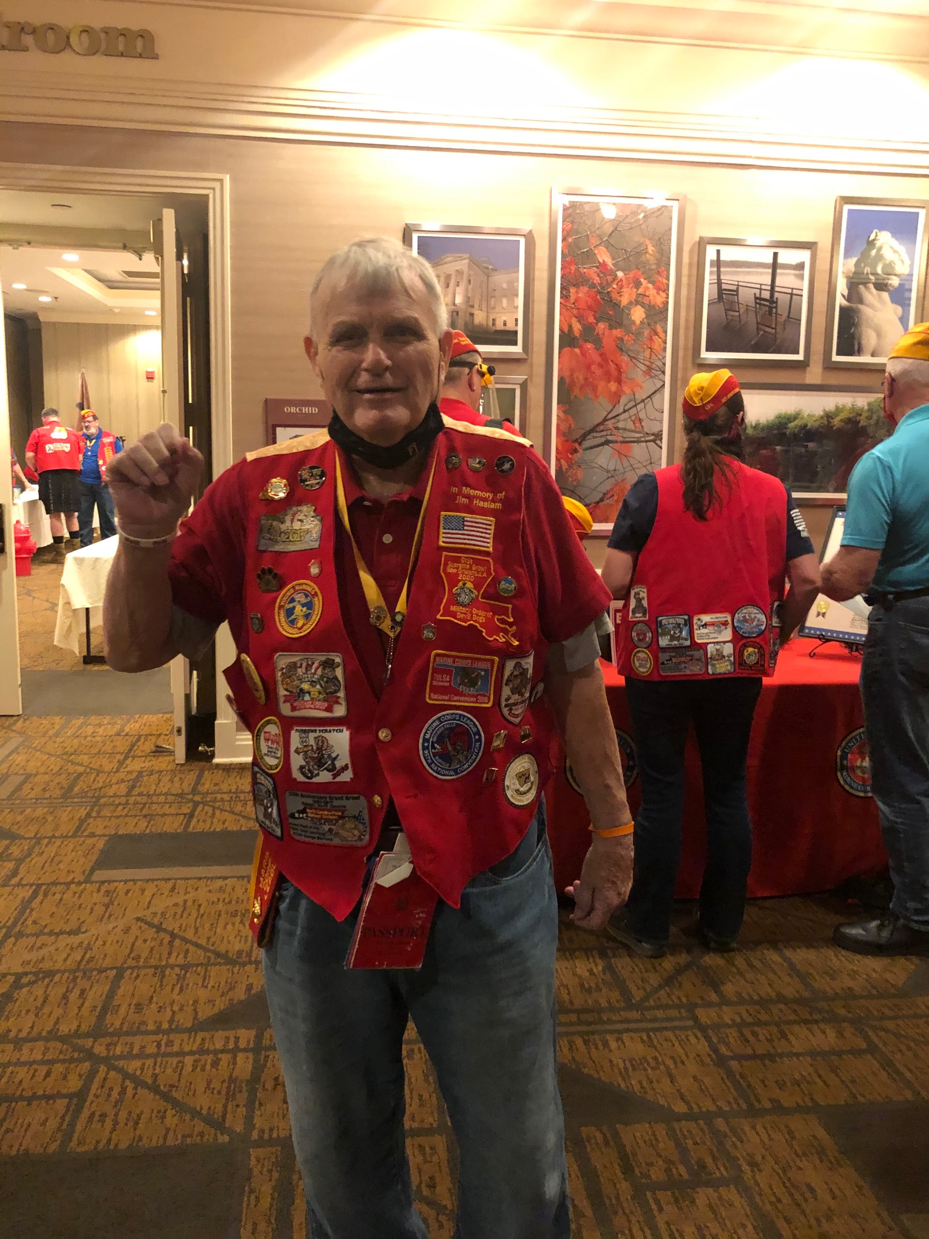
Department of North Carolina
Marine Corps League
2021 Spring Meeting

Slide 8
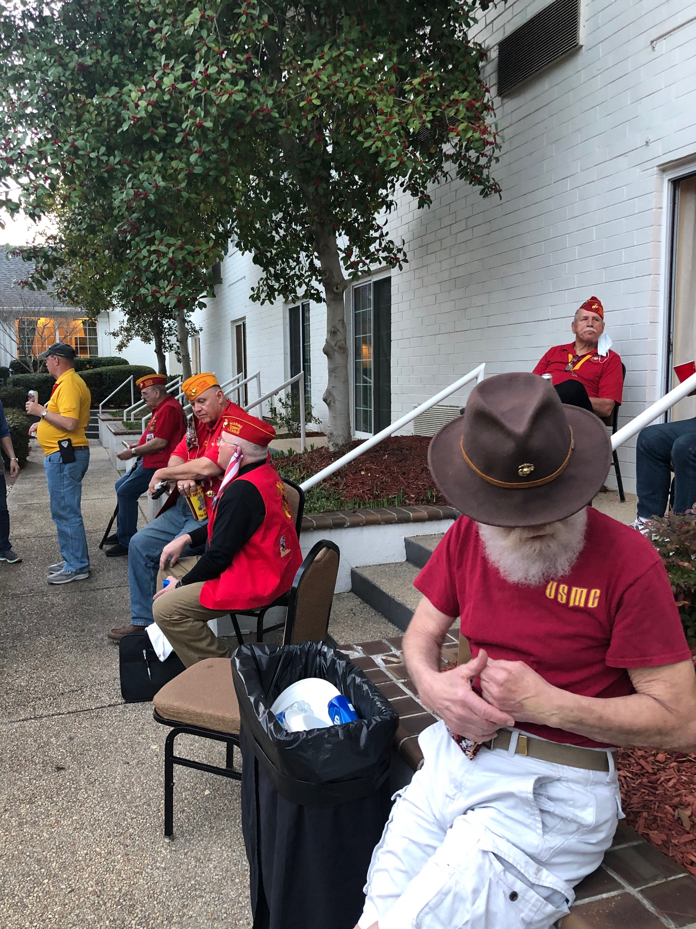
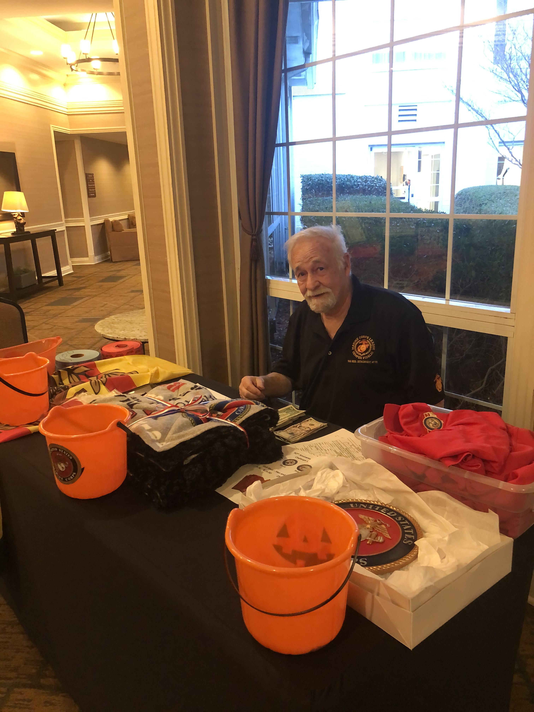
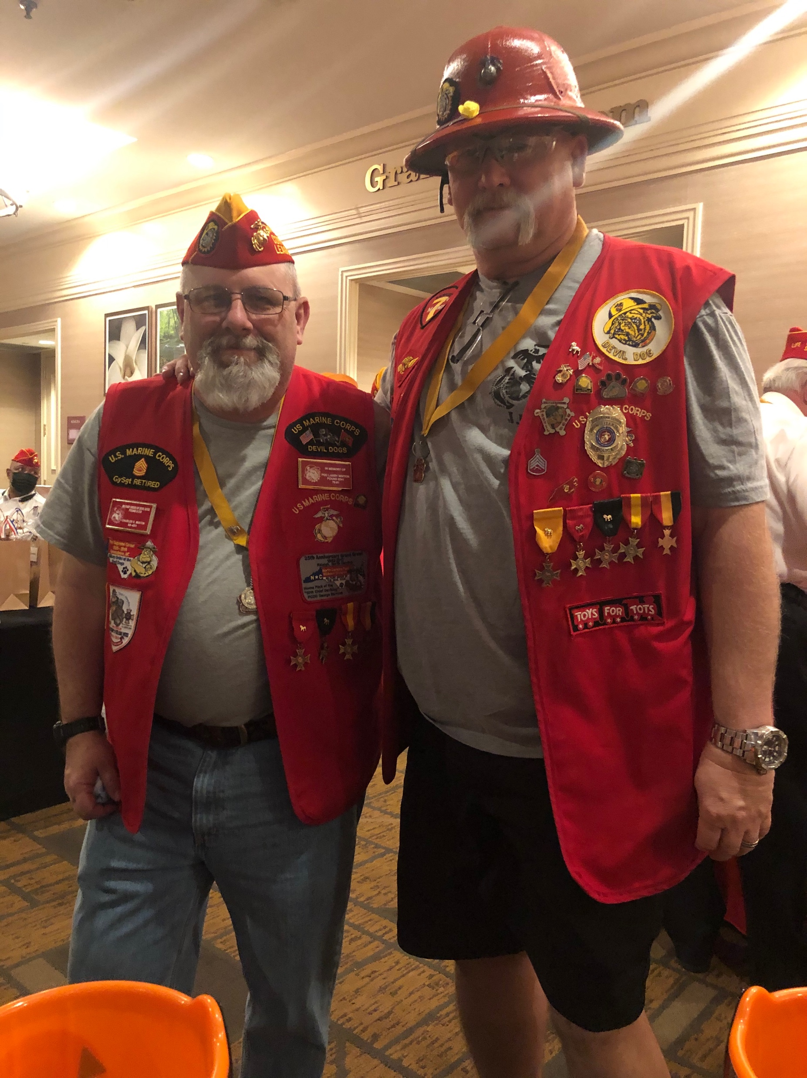
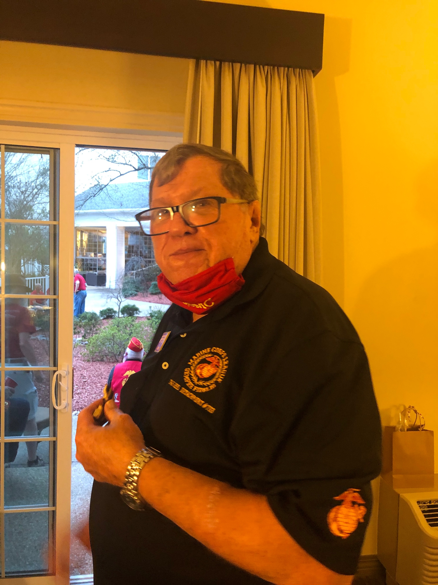
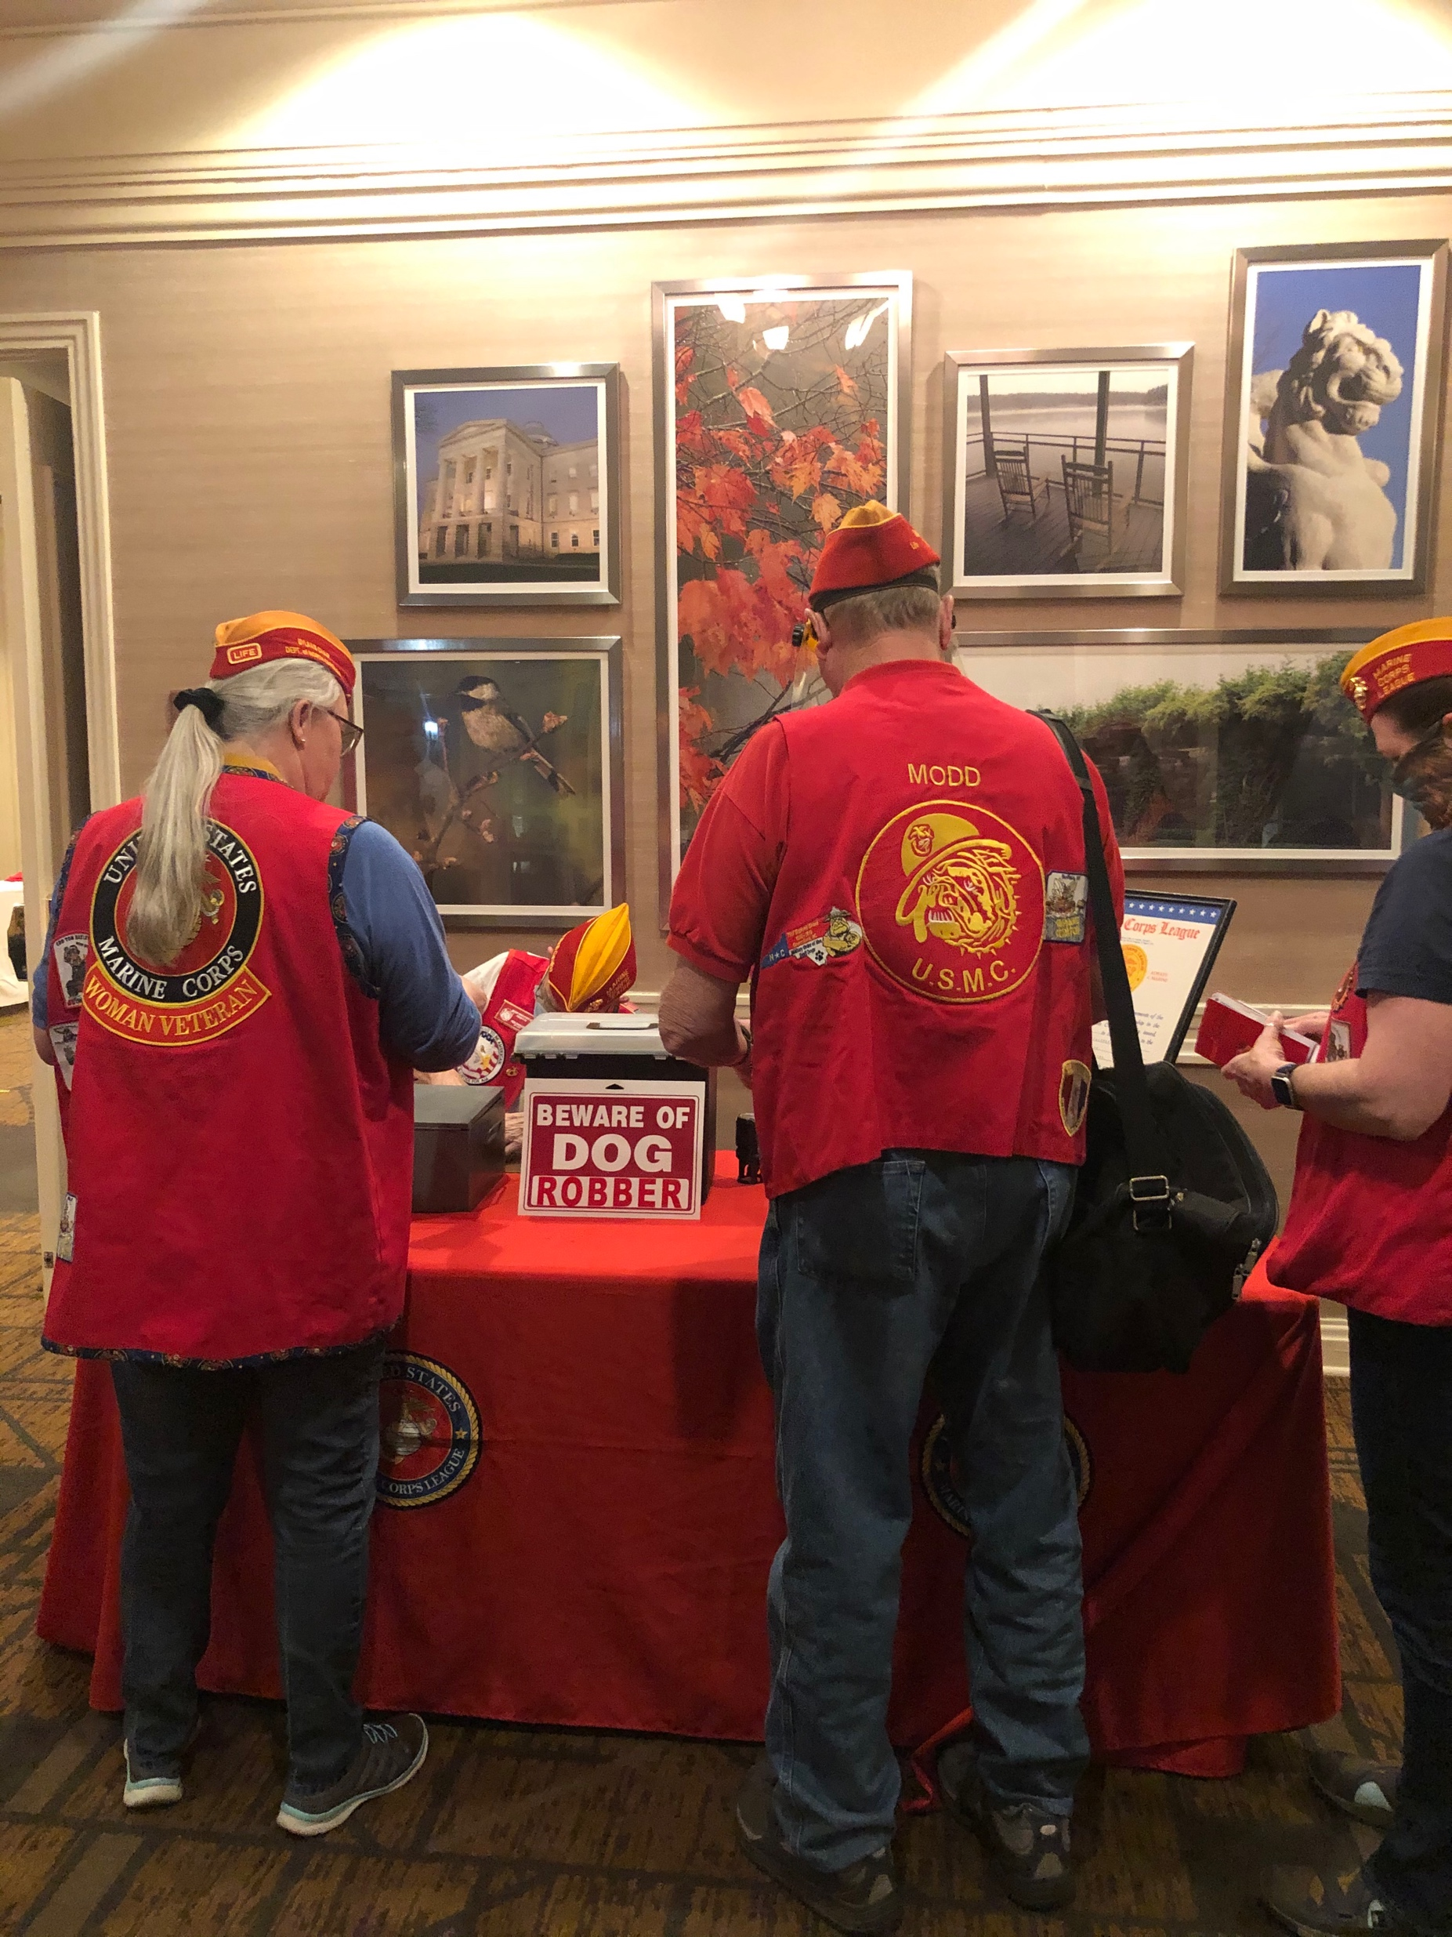
Department of North Carolina
Marine Corps League
2021 Spring Meeting

Slide 9
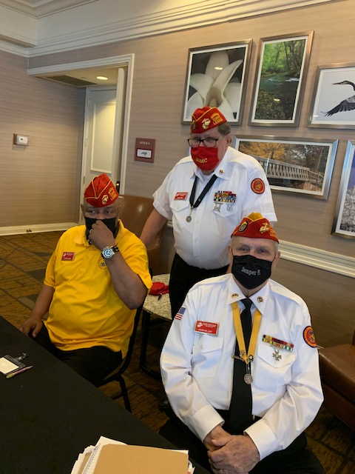
Department of North Carolina
Marine Corps League
2021 Spring Meeting

Slide 10
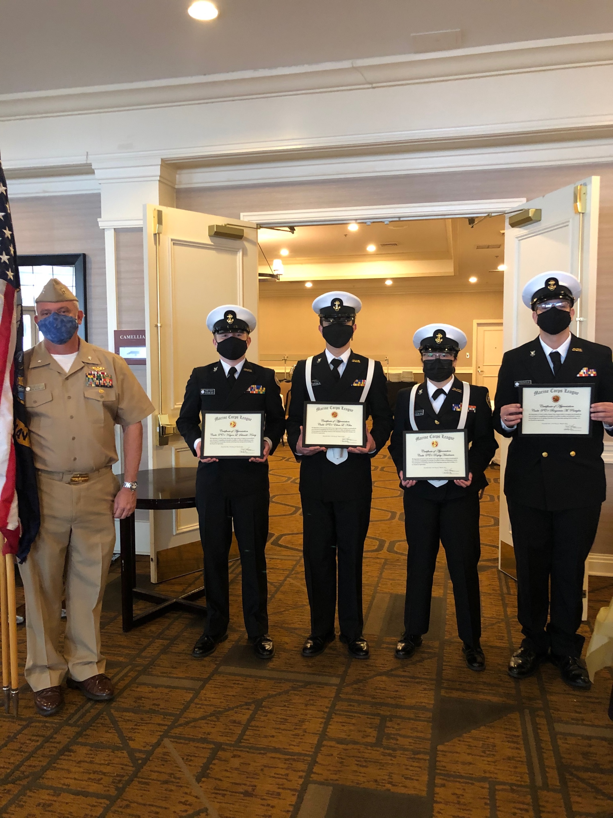
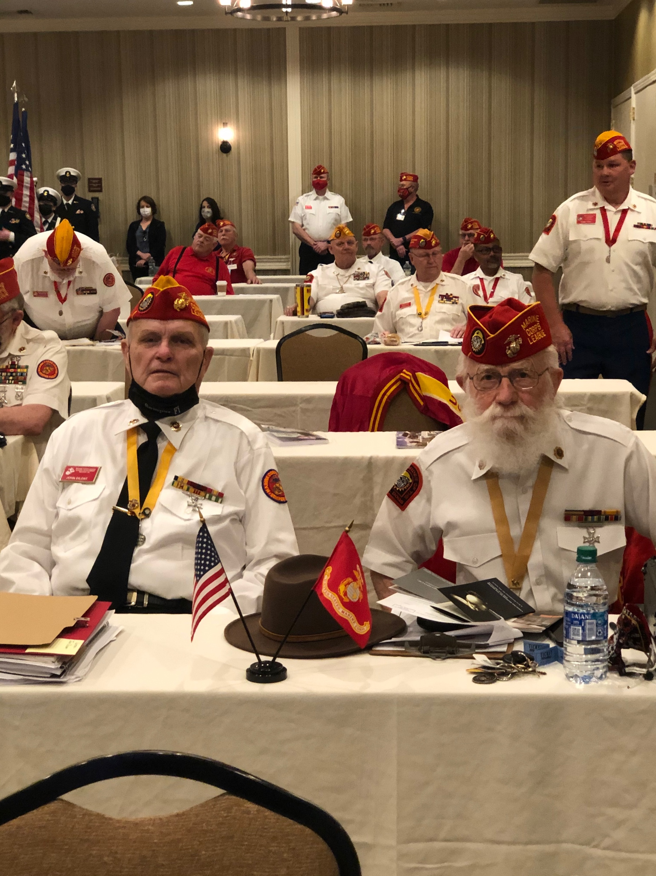
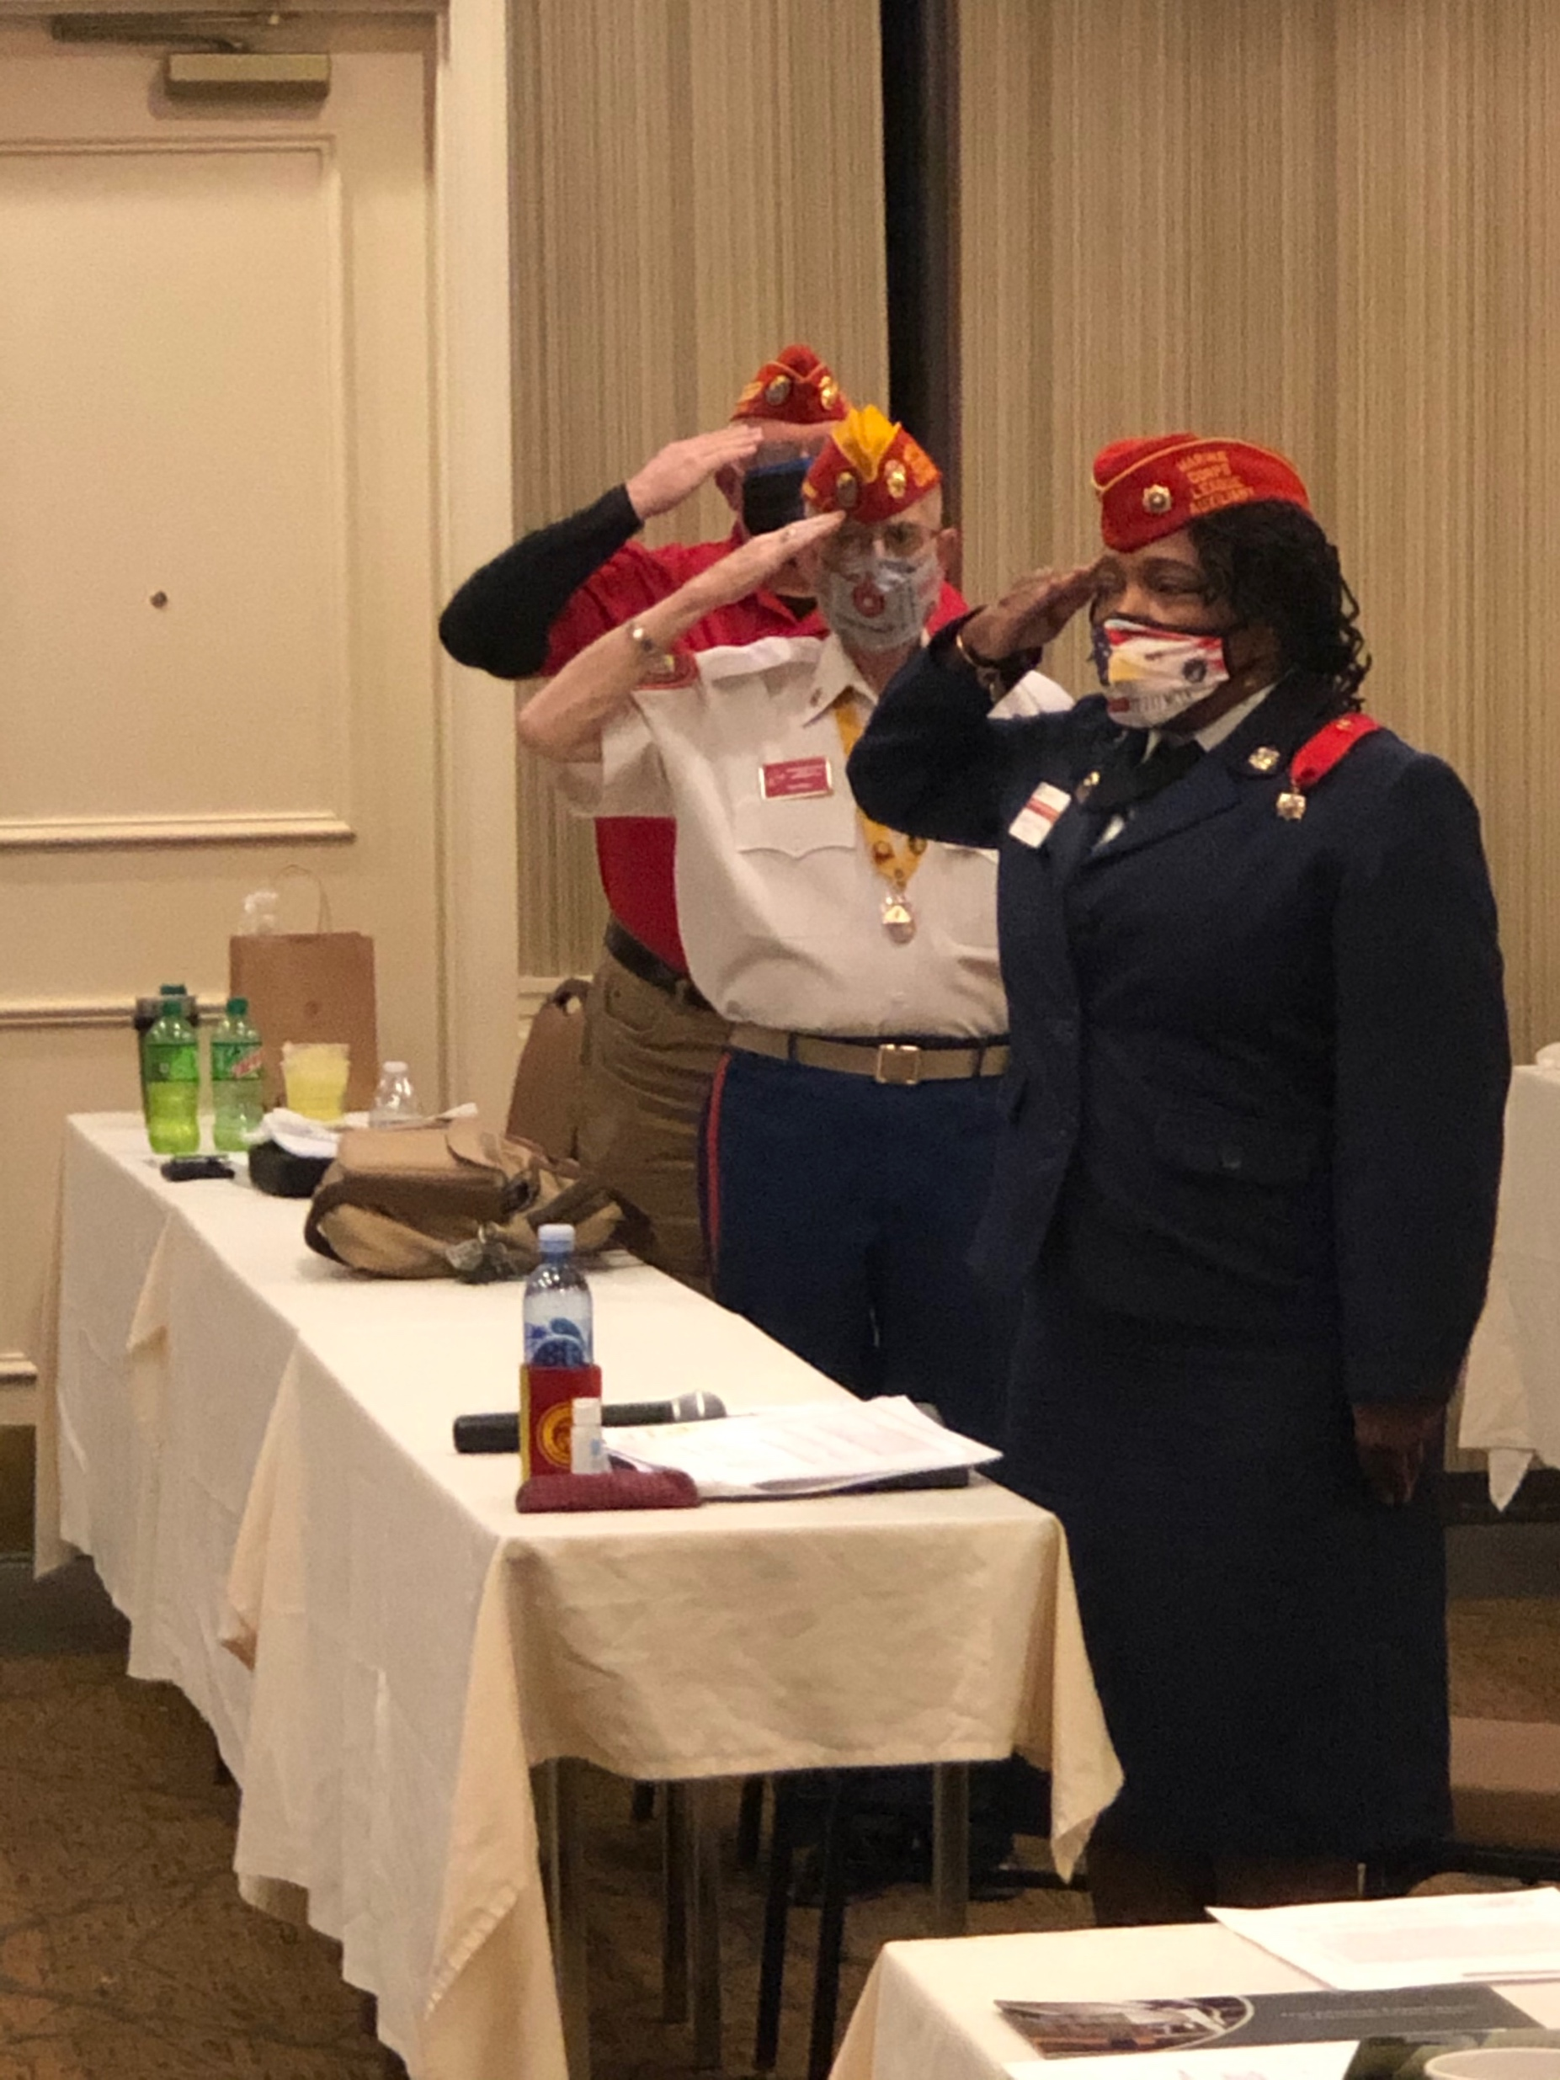
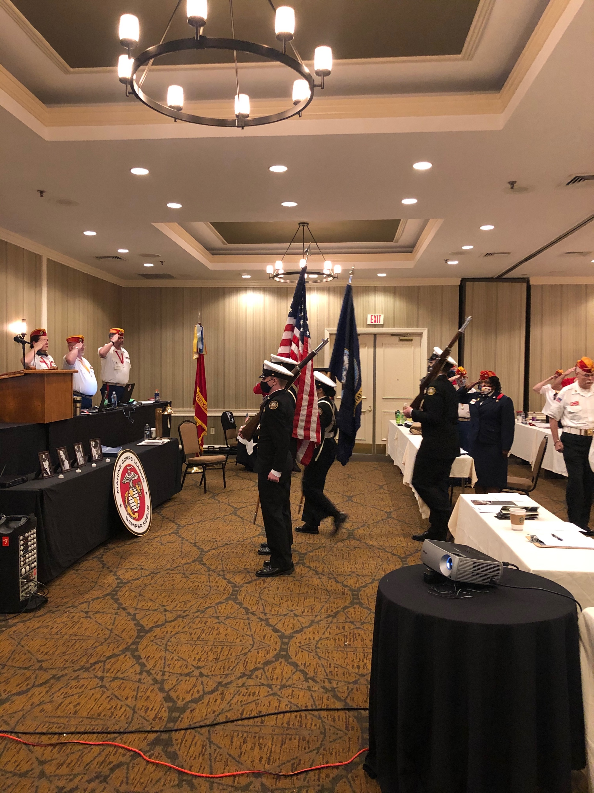
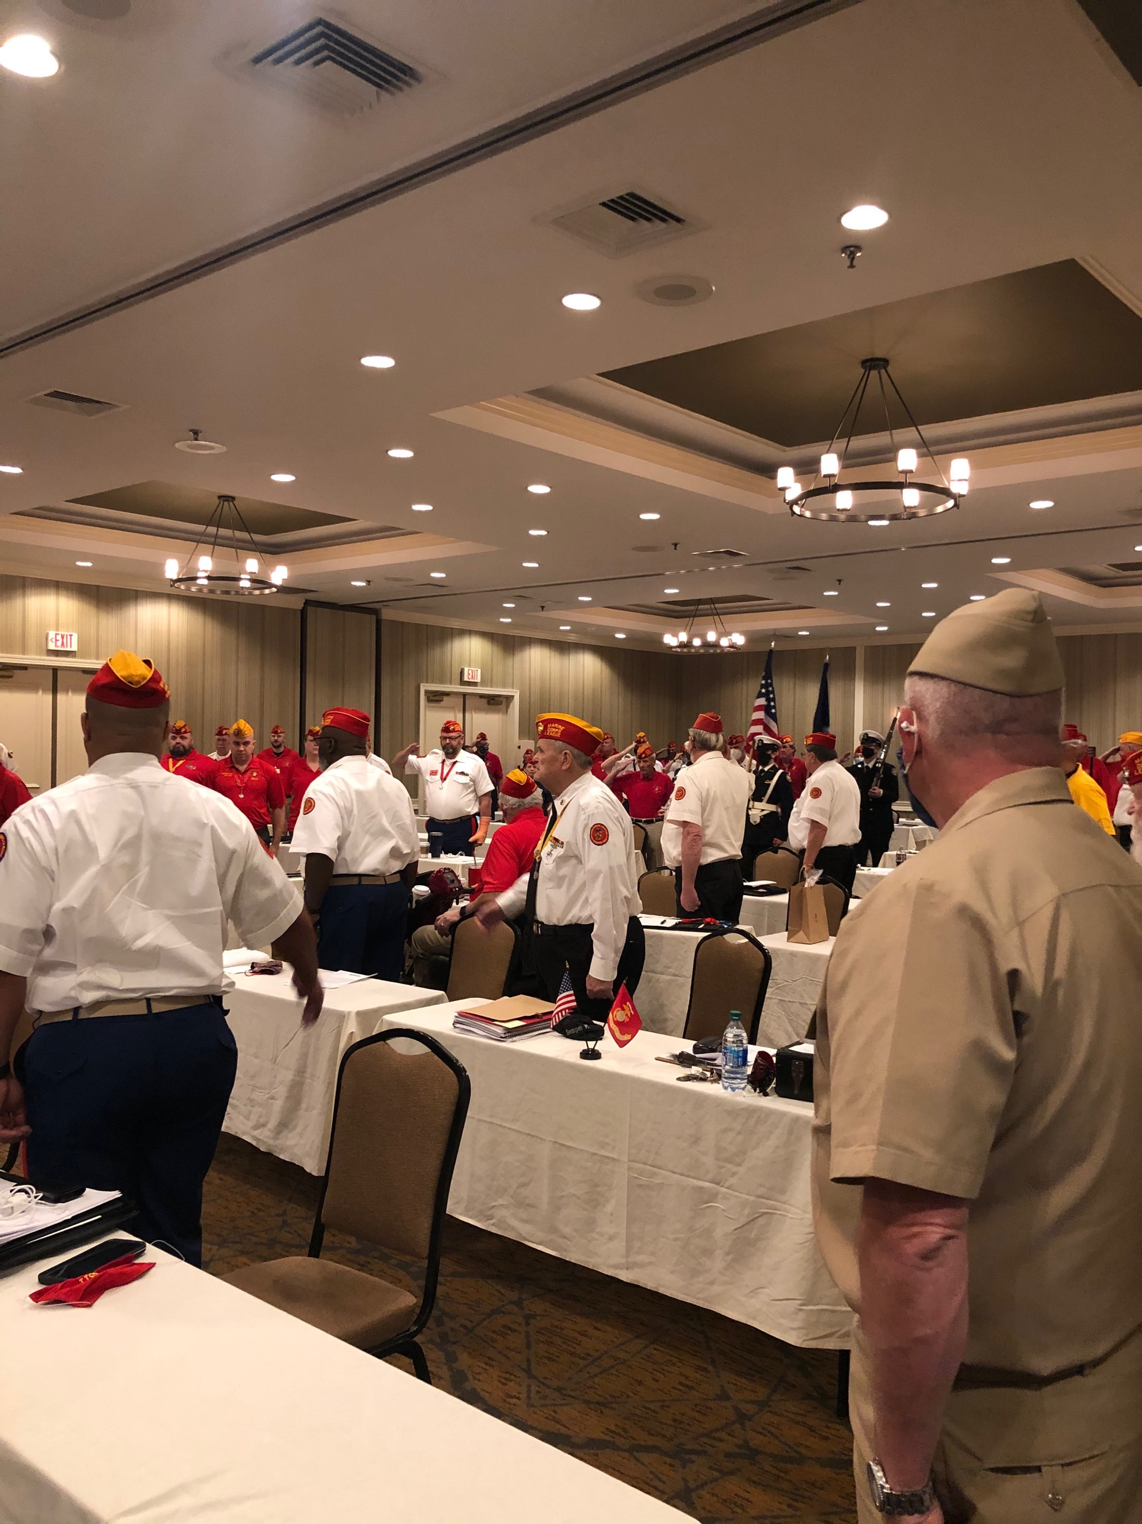
Department of North Carolina
Marine Corps League
2021 Spring Meeting

Slide 11
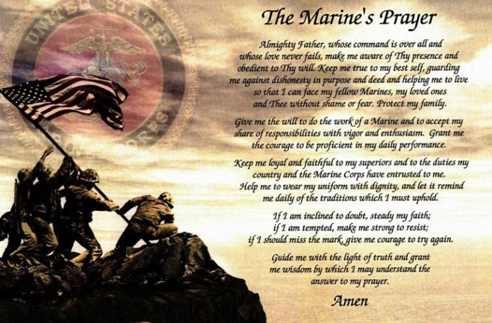
Chaplain’s Corner
Pray for Toby Robert’s health for a quick recovery.
Pray for our elderly members of the Detachment: Joe Zaytoun, Jim Niver, Nate Griffin.
Pray for Pamela Thomas and her family who continue to undergo rough times - Cancer
Pray for Richard Patrick and wife Cam
Pray for Matt Stokes’ wife Louise who has a heart condition.
Pray for our departed MCL Detachment member Dorset Clements

Slide 12
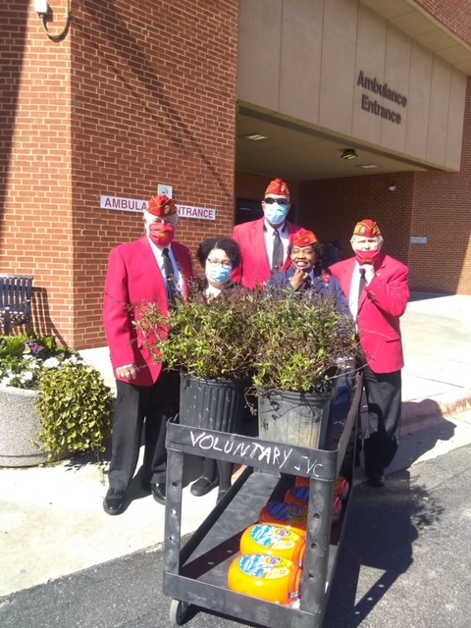
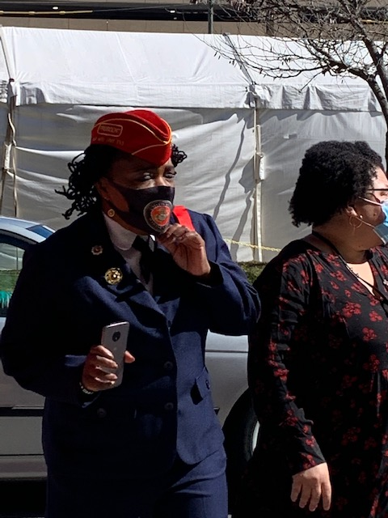
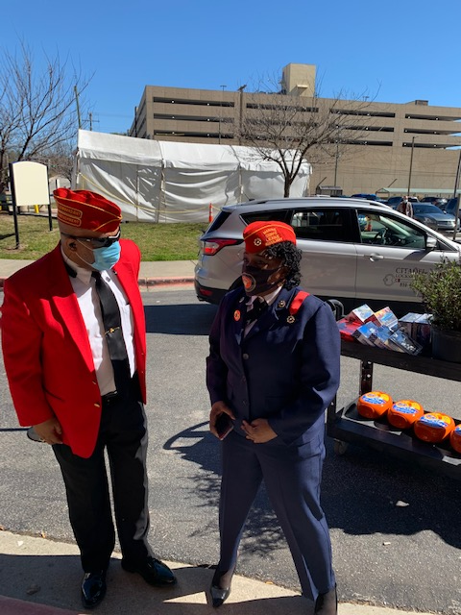
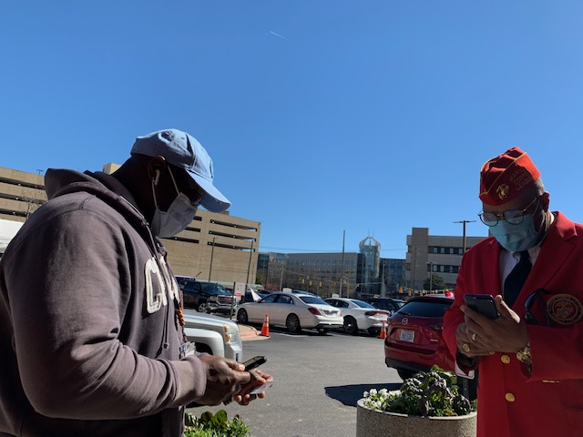
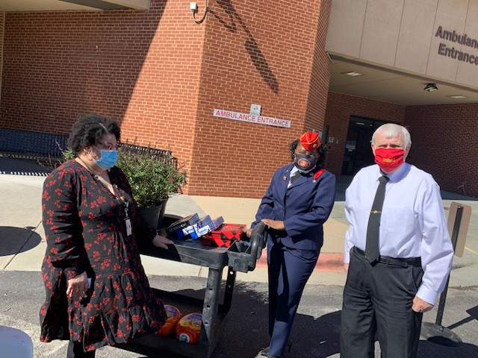
Marine Corps league auxiliary
Good afternoon, I hope this finds you and your families doing well! MANY THANKS & BRAVO ZULU for collaborative efforts yesterday to honor 2021 National Salute to Veteran Patients . Veterans serving Veterans is a way of life for me! I totally BELIEVE that "Integrity, Commitment, Advocacy, Respect and Excellence" (I CARE) is what should motivate us all for reasons "why we do what we do"! I do regret the confusion with arrival time and that Toby missed our "photo shoot"! We look forward to serving together as the Auxiliary adjusts to major transitions in pursuit of our mission to CONTINUE to "passionately support each other while serving our Marines, their families, our communities and All Veterans"!
Sincerely,
Pamela P. Thomas, President
Tar Heel Unit 733 Marine Corps League Auxiliary (MCLA)
(Cell) 919-995-8802
Facebook Page: https://www.facebook.com/TarHeelUnit733MCLA/

Slide 13
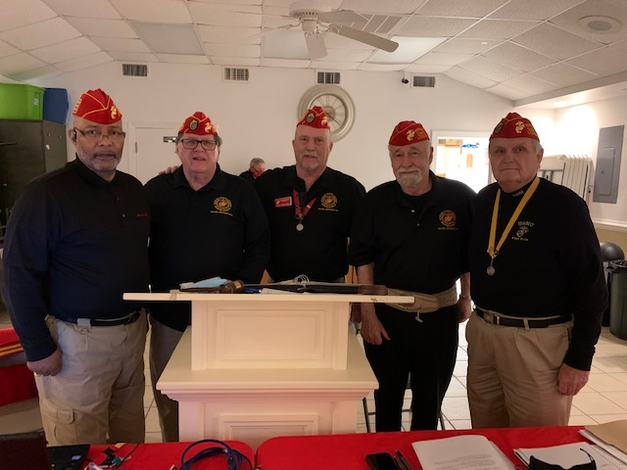
Marine Corps League
March Meeting
Congratulations to
Tar Heel Detachment #733
2021
Marine Corps League Officers

Slide 14
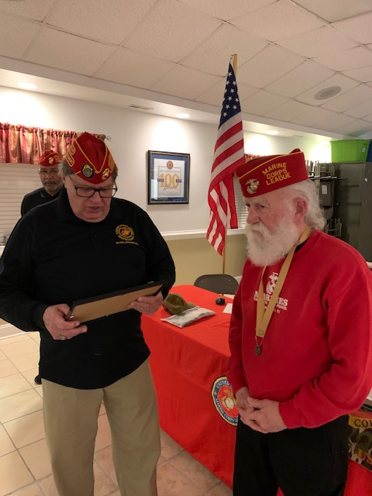
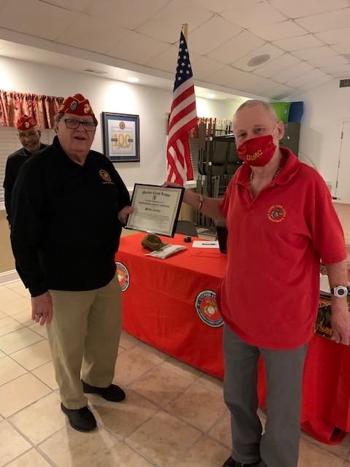
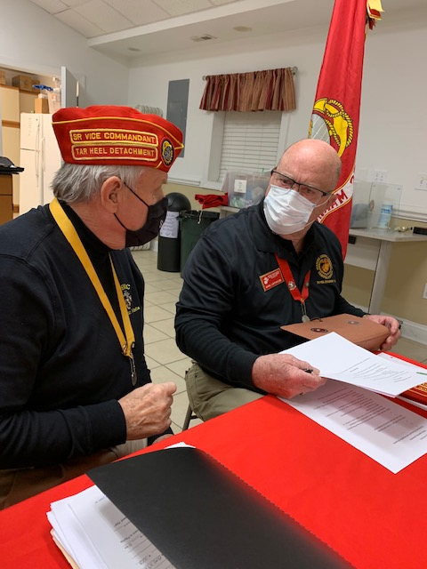
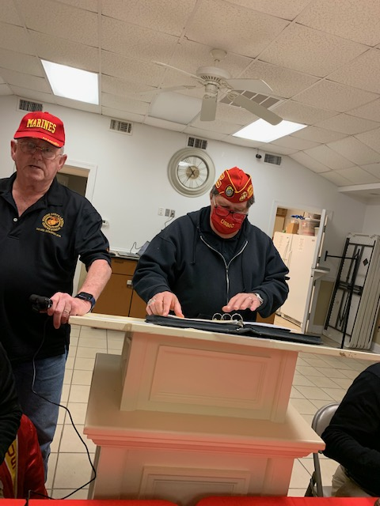
Marine Corps League
March Meeting
Al Pasquale and Steve Curlee received Marine Corps League awards for outstanding support

Slide 15
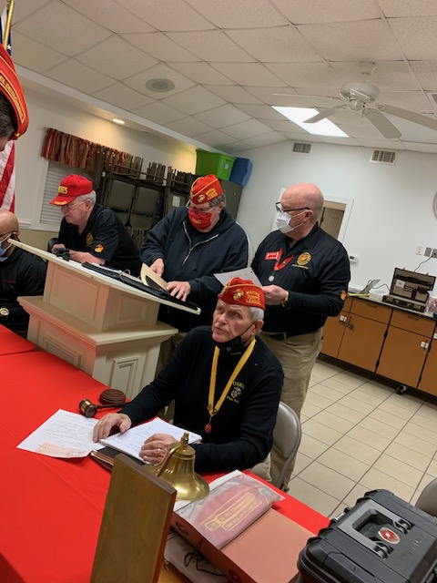
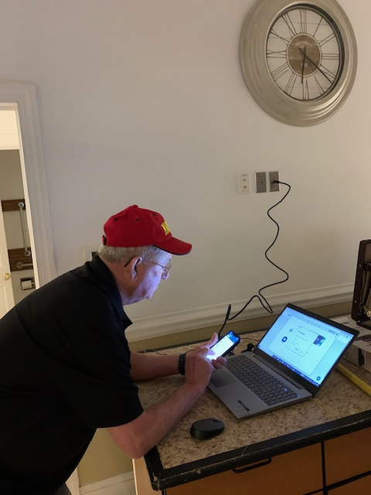
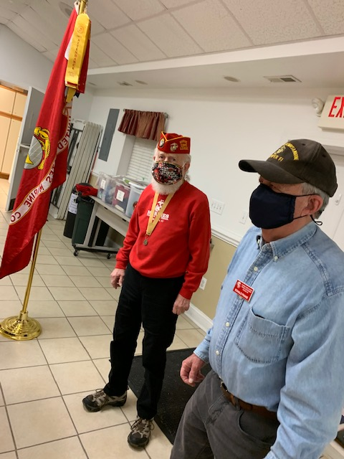
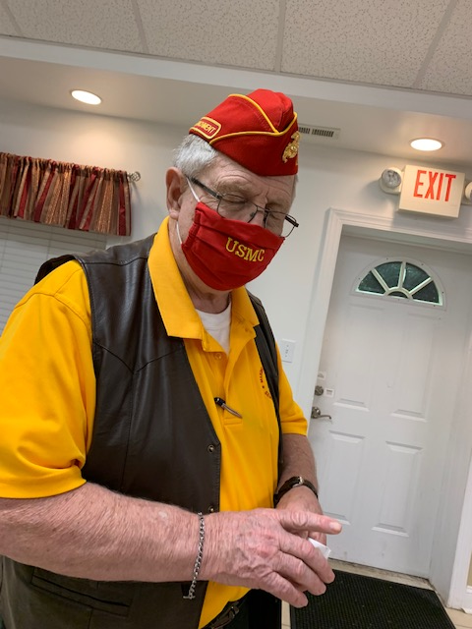
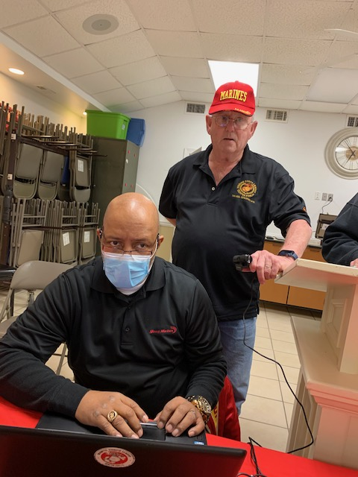
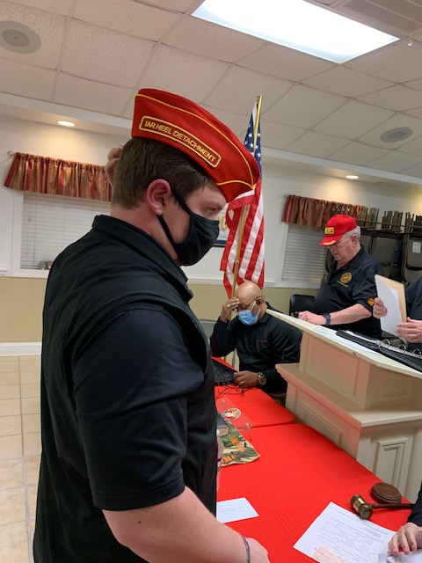
Marine Corps League
March Meeting

Slide 16
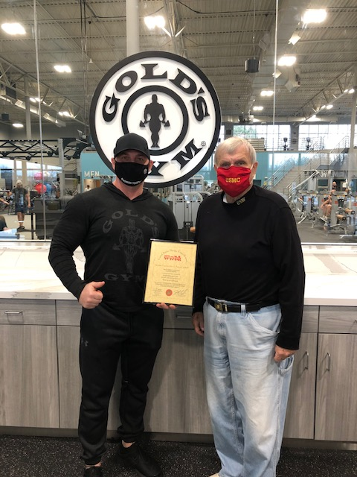
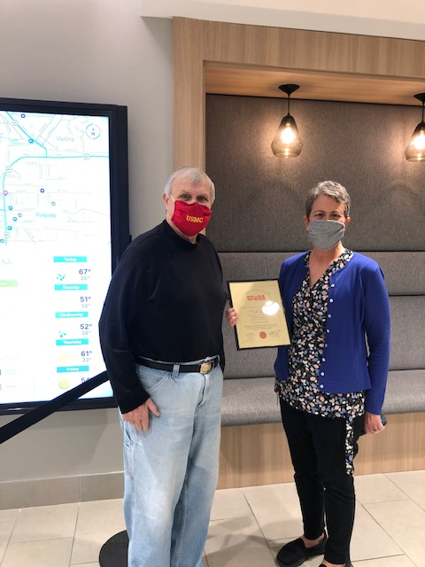
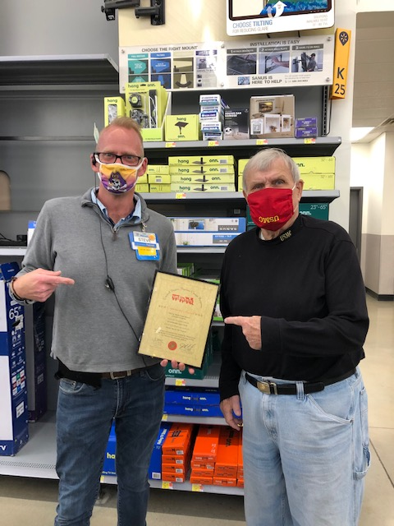
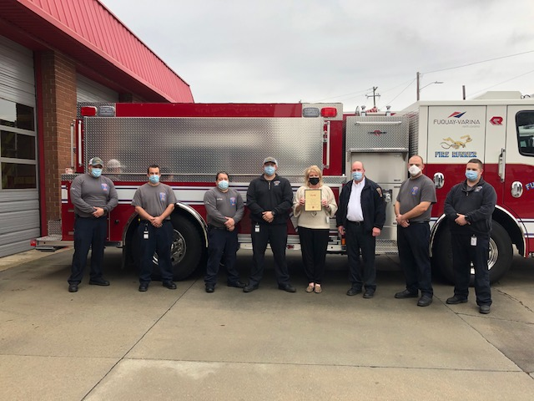
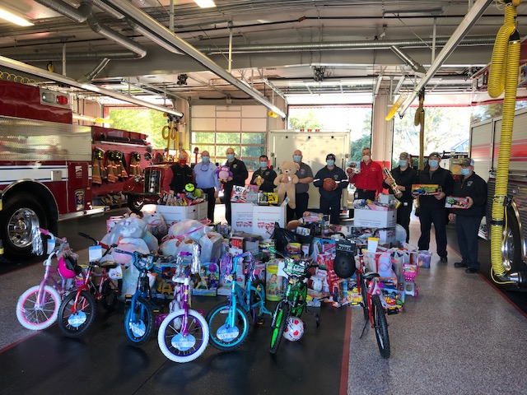
Tar Heel Detachment #733
Recognition for Exemplary Service
Fuquay Varina championed toys for tots – City Government, Gold’s Gym, Fire Dept., and Wal Mart donated numerous toys.
Staff Sergeant Coleman North Carolina
Recruiter of the year

Slide 17
Marine Corps League
At Fortnite Brewery with the
Marine for Life Network

Slide 18
Marine Corps League
At Fortnite Brewery with the
Marine for Life Network

Slide 19
Adopt A Highway

Slide 20
Adopt A Highway

Slide 21
Historical Events
Interesting Tar Heel Detachment #733 History
1997 began with Ms. Jeri Beard of the Detachment receiving a plaque from the MCL Department of NC for Woman of the Year for her great service. Robert McCollum became the new Commandant of the Detachment. The Tar Heel’s Detachment major fund raiser, the 4th Memorial Run for Fun Annual Car and Truck Show was held on May 10th and raised $1,100 for Toys for Tots and other programs. Fun activities included toilet paper toss, lug nut toss, and the fan belt game. The Detachment supported the NC Vietnam Veterans, Inc. in their POW-MIA campaign. 1997’s Marine Corps Birthday Ball was held in the Hilton Hotel in Raleigh.
Sean Van Pallandt Historian
USMC March History
13 March 1943: The first group of 71 Women Marine officer candidates arrived at the U.S. Midshipmen School (Women's Reserve) at Mount Holyoke College in South Hadley, Massachusetts. The Navy's willingness to share training facilities enabled the Marine Corps to begin training Marine Corps Women's Reserve officers just one month after the creation of the MCWR was announced.
17 March 1967: The first woman Marine to report to Vietnam for duty, Master Sergeant Barbara J. Dulinsky, began her 18-hour flight to Bien Hoa, 30 miles north of Saigon. MSgt Dulinsky and the other officer and enlisted Women Marines that followed were assigned to the Military Assistance Command; Vietnam (MACV) based in Saigon. Most worked with the Marine Corps Personnel Section providing administrative support to Marines assigned as far north as the DMZ, but two Lieutenant Colonels, Ruth Reinholz and Ruth O'Holleran, served as historians with the Military History Branch, Secretary Joint Staff, MACV.
25 March 1945: After 35 days of bitter fighting, the amphibious assault on the rocky fortress of Iwo Jima finally appeared over. On the night of 25 March, however, a 300- man Japanese force launched a vicious final counterattack in the vicinity of Airfield Number 2. Army pilots, Seabees and Marines of the 5th Pioneer Battalion and 28th Marines fought the fanatical Japanese force till morning but suffered heavy casualties -- more than l00 killed and another 200 American wounded. Nearly all of the Japanese force was killed in the battle.
27 March 1953: The 5th Marines, supported by the 2d Battalion, 7th Marines, in the first full day of fighting after the Chinese assault the previous evening of Outpost Vegas on Korea's western front, counterattacked to regain enemy-held positions. Companies E and F of 2/7, down to only three platoons between them, managed to regain partial control of Outpost Vegas that day

Slide 22
Adjutant Corner
I asked a friend who has crossed 70 & is heading towards 80 what sort of changes he is feeling in himself? He sent me the following:
After loving my parents, my siblings, my spouse, my children and my friends, I have now started loving myself.
I have realized that I am not “Atlas”. The world does not rest on my shoulders.
I have stopped bargaining with vegetable & fruit vendors. A few pennies more is not going to break me, but it might help the poor fellow save for his daughter’s school fees.
I leave my waitress a big tip. The extra money might bring a smile to her face. She is toiling much harder for a living than I am.
I stopped telling the elderly that they've already narrated that story many times. The story makes them walk down memory lane & relive their past.
I have learned not to correct people even when I know they are wrong. The onus of making everyone perfect is not on me. Peace is more precious than perfection.
I give compliments freely & generously. Compliments are a mood enhancer not only for the recipient, but also for me. And a small tip for the recipient of a compliment, never, NEVER turn it down, just say "Thank You.”
I have learned not to bother about a crease or a spot on my shirt. Personality speaks louder than appearances.
I walk away from people who don't value me. They might not know my worth, but I do.
I remain cool when someone plays dirty to outrun me in the rat race. I am not a rat & neither am I in any race.
I am learning not to be embarrassed by my emotions. It’s my emotions that make me human.
I have learned that it's better to drop the ego than to break a relationship. My ego will keep me aloof, whereas with relationships, I will never be alone.
I have learned to live each day as if it's the last. After all, it might be the last.
I am doing what makes me happy. I am responsible for my happiness, and I owe it to myself.
Happiness is a choice. You can be happy at any time, just choose to be!
Why do we have to wait to be 60 or 70 or 80, why can't we practice this at any stage and age?

Slide 23
Marine Corps League
March 3, 2021
Minutes
1. Opening Ceremony: At 1900 hours, Colors Posted and Allegiance to flag was recited.
A. Meeting was conducted at American Legion Post 67, Cary, NC. by Commandant Jim Lewis.
B. Welcome To All: Total Present 24 in attendance, with 12 on Zoom & 3 guests.
C. Meeting status: There was a quorum present.
2. Recognition of All Guests:
A. Rick Thomason: Commandant DoNC.
B. William Brown: North District Commandant DoNC.
C. Laura Hamilton Adjutant DoNC.
3. Roll Call of Officers:
PRESENT: Jim Lewis, Commandant; John Dilday, Sr Vice Commandant; Gene Taxis, Adjutant/ Paymaster; Jason Hall, Chaplain (Zoom); Earl Linthicum Jr. Vice Commandant; Tyrone Ashe, Judge Advocate; Sean Van Pallandt Historian (zoom); David Gardener, Eagle Scout Coordinator (Zoom) Bruce Goeden, Jr. Past Commandant; James Mitchell, Web Site & Zoom Coordinator. EXCUSED: Pamela Thomas, President Tar Heel # 733 Woman’s Auxiliary (zoom); Toby Roberts, Sgt at Arms;(Al Pasquale stood in as Sgt at arms); and Jeremy Tank Facebook.
4. Any Applications for Membership or Transfer: David Matthews: Submitted paperwork and DD214 for review- took the oath of membership via zoom. Welcome aboard
5. Our Minutes of the Previous Meeting on February 3, 2021: Were published in the Scuttlebutt and emailed to everyone. No corrections, Motion to Accept -By Tyrone Ashe 2nd By: Earl Linthicum, No Discussion –Voice Vote - Approved
6. Correspondence: All correspondence from Dept. of NC has been forwarded to all members via E-mail and the Scuttlebutt.
7. Paymaster Report: For the month of February 2021.
Check Book Balance 1/31/2021 (See web site “members only” section) Income: $187.00, total Expenses: 0.00 - Outstanding checks $215.00 – Flower fund $150.00 - 2 CDs - earned .66 interest - CD Bal as of 1/31/2021 $2171.00 - Motion to Accept Paymaster’s Report Subject to Audit by Tyrone Ashe and 2nd by Earl Linthicum- No Discussion – Hand and Voice Vote – Approved.
Two members are delinquent in dues as of 1/31/2021- James White and Anthony D’Angelo
****** Full Paymaster Report can be viewed in “members only” section on website. ******
8. Chaplain: Do We Have Any Reports of Sickness, Distress or Death:
A. Toby Roberts has a serious problem with his toe and needs some prayers for his quick recovery.
B. Pray for all members of our Detachment who are up in age: Joe Zaytoun, Jim Niver. Nate Griffin.
C. Pamela Thomas and her family continue to undergo rough times - Cancer (Keep them in your prayers).
D. Richard Patrick and wife Cam / (Keep them in your prayers).
E. Matt Stokes’ wife Louise has a heart condition. Improving in health (Keep her in your prayer).
F. Bruce Goeden briefed the upcoming service for departed MCL Detachment member Dorset Clements. Funeral in Raleigh 12 March 2021
G. No KIA or missing Marines, Corpsman, or Navy Chaplains to report.

Slide 24
Marine Corps League
March 3, 2021
Minutes
9. Standing Committee Reports:
A. Sr. Vice Comm – John Dilday – Briefed progress of MCL Spring Meeting 12-13 March 2021 at the Double Tree Hotel RTP/Durham, NC. - Det 733 will man registration and fund raising / raffle tables (Fri- Sat) Hospitality room set up Friday at Noon, Devil Dog Growl Fri. Evening.
B. Jr. Vice Commandant – Earl Linthicum briefed membership roster is being updated, 2 Marines remain delinquent in dues. 1 member at large, 2 deceased.
C. Judge Advocate –Work on Bylaws continues – in the final phase - (April meeting for reading and ratification). Corrections back from D Mathias DoNC SJA to be included in our Bylaws.
D. Public Relations – Gene Taxis – Adopt a Hwy. clean- up was a complete success. Participants were John Saitta, Steve Curlee, Bruce Goeden, Dave Gardener, Bill Cargill, Gene Taxis, Jim Lewis. 9 bags collected with the most unique item found being a red braw. (Yes, found by Steve Curlee).
E. Web Site and Facebook - James Mitchell coordinated the zoom meeting with Tyrone. Audio poor & need work. A few members had technical difficulties getting online. - Special note: Web site is current, and to get the password or to make a correction in the “members only” section, contact the adjutant at 919-448-6596 or gene.marine1@gmail.com.
F. Jeremy Tank – Facebook always needs new material.
G. Sgt. At Arms – Toby Roberts excused -Al Pasquale filled in.
H. Monthly Shoot Activity – same status
I. Eagle Scouts – David Gardener – no report.
J. Historian – Sean Van Pallandt- (Zoom) briefed a short MCL excerpt from the March 1997 Scuttlebutt post. (see History section of March Scuttlebutt.)
K. Tyrone Ashe – Budget and Finance: The required Paymasters March audit was complete with no major discrepancies. All forms and paperwork were included in the appropriate folders (Oct 2020 – Jan. 2021). Next audit scheduled for April.
L. Capital City Young Marines -Tyrone Ashe reported Marine Greg Ross will assume the duties of Commander of the CCYM,
M. VA updates and activities: John Dilday reported that Pam coordinated delivery of over $400. 00 of donated items to the National Veterans in Hospice program. Thanks to Pam Thomas’ coordination laundry detergent, live plants, model cars, and body cologne was delivered to the Durham Va. Hospital.
N. Marines for Life (Jeremy Tank) Marines of the League met at Fortnite Brewery for 3 hour social. Met a number of Marines all having stories to tell. Good time was had by all.
10. Unfinished Business
A. John Dilday briefed the upcoming Department Spring meeting scheduled for 12 -13 of March 2021 is proceeding as planned. The Double Tree is receiving reservations now which will be confirmed if COVID 19 restrictions are lifted. John Dilday, Gene Taxis, and Jim Mitchell will continue to coordinate with the hotel and MCL and give updates as they occur. He needs you to get your registrations to him as soon as you can.
B. Update on Memorial Day (John Saitta is Chairman). I’m sure he will not turn down any help.

Slide 25
Marine Corps League
March 3, 2021
Minutes
11. New Business:
A. The Paymasters audit was conducted as required by our Bi-laws covering the change of paymasters. No major deficiencies were reported. Present for audit were John Dilday, Gene Taxis, John Saitta, Toby Roberts, Tyrone Ashe. Suellen Beaulieu, Jason Hall, & Russ Oliver worked on proposed 2021-2022 budget.
B. John Dilday briefed the proposed 21-22 budget which had been emailed to all members and inserted onto the “members only” Tarheel 733 website. Motion to accept the proposed budget was made by Tyrone Ashe, 2nd by Earl Linthicum. No discussion – By voice and hand vote budget 2021-22 approved
12. Good of the League:
A. Steve Curlee received award outstanding support acting as SGT at Arms in Kevin’s absence.
B. Al Pasquale received award for outstanding support to the MCL = He was responsible for getting over ½ ton of dog food in support of recent MCL Devil Dogs Growl.
C. Al Pasquale presented an idea for a fund raiser / covered dish (Wives to bring a covered dish to the VFW 1st WED nights of the month, April, July, Oct, &Jan 2022. More to follow.
D. Thanks to a great staff, this month has been a busy one. The sword for the outstanding recruiter was presented. The budget is ready to be voted on and starts in April, thanks in great part to the return of Suellen and the hard work of Russ Oliver and Jason Hall.
E. The accounts were turned over at the PNC bank, the Paymasters report was presented in a timely manner, and the audit was done for the change of Paymasters as per the bylaws.
E. The Quarterly Report is in on time to headquarters.
F. The forms for the NC state NROTC/MECEP sword were sent to NC State so they could start the process of picking out the student that will enter the Marine Corps as a LT. (By the way, this year there are 9 to pick from.)
G. Rick Thomason Cmdt. DoNC requested all members go to the National web site and update their personal profile which will increase the accuracy of the National roster
13. Announcements:
Remember the DONC 2021 Spring Membership meeting on March 12 & 13.
Dates to put on your calendar:
April 7- Next meeting
May 31 - Memorial Day
September - Annual Picnic (date to be announced).
October 23 - Beirut Remembrance.
November - The Birthday Ball (date to be announced).
November 11 - Veterans Day Parade and Lunch.
December - Christmas Party (date to be announced).
14. Closing Ceremony! 19:30

Slide 26
Marine Corps League Raffle

Slide 27
March 2021
SUNDAY |  | MONDAY | TUESDAY | WEDNESDAY | THURSDAY | FRIDAY | SATURDAY
 | 28 | 1 | 2 | 3 | 4 | 5 | 6
 |  |  | DANIEL NICHOLS | JOHN BOOTH TARHEEL MCL MEETING 7:00PM |  |  | TYRONE ASHE
 | 7 | 8 | 9 | 10 | 11 | 12 | 13
 |  |  |  |  | ROBERT FEDERICO
 | 14 | 15 | 16 | 17 | 18 | 19 | 20
 | 21 | 22 | 23 | 24 | 25 | 26 | 27
 |  |  | GREGORY ERICKSON
 | 28 | 29 | 30 | 31 | 1 | 2 | 3
 |  |  |  |  |  | Good Friday
April 2021
SUNDAY |  | MONDAY | TUESDAY | WEDNESDAY | THURSDAY | FRIDAY | SATURDAY
 |  |  |  |  | 1 | 2 | 3
 |  |  |  |  |  | Good Friday
 | 4 | 5 | 6 | 7 | 8 | 9 | 10
Easter Sunday |  | EDWIN WELCH |  | TARHEEL MCL MEETING 7:00PM
 | 11 | 12 | 13 | 14 | 15 | 16 | 17
 |  | JEREMY TANK |  |  |  |  | MICHAEL SNYDER
 | 18 | 19 | 20 | 21 | 22 | 23 | 24
 | 25 | 26 | 27 | 28 | 29 | 30 | 1
 |  |  |  |  |  | RICHARD PATRICK

